Slide 1
Basics of Onsite Wastewater Treatment
Homeowner Education
Notes:
These training materials were developed by Sara Heger (sheger@umn.edu) and John Buchanan (jbuchan7@utk.edu). Please email with questions, edits, or needed additions.
Add regional, organization, or company logo in the picture frame in the center.
Note: Modify the presentation to fit the systems and community you are providing training for along with the time available. Add regional logo in picture frame in center
This presentation is the first in a four-part series that provides basic information about how an onsite wastewater treatment system removes waste products from water, how they are installed and how they should be maintained.

Slide 2

National Onsite Wastewater Recycling Association
The largest U.S. organization devoted exclusively to supporting members of the onsite and decentralized industry
Mission:
  To strengthen and promote the onsite and decentralized wastewater industry through activities that support recognition and promotion of professionalism for industry practitioners
  To implement best management practices throughout the industry that provide sustainable wastewater infrastructure solutions
  To achieve greater public awareness of the economic, environmental, and public health benefits of onsite and decentralized facilities
  www.nowra.org
Notes:
This slide introduces NOWRA.

Slide 3
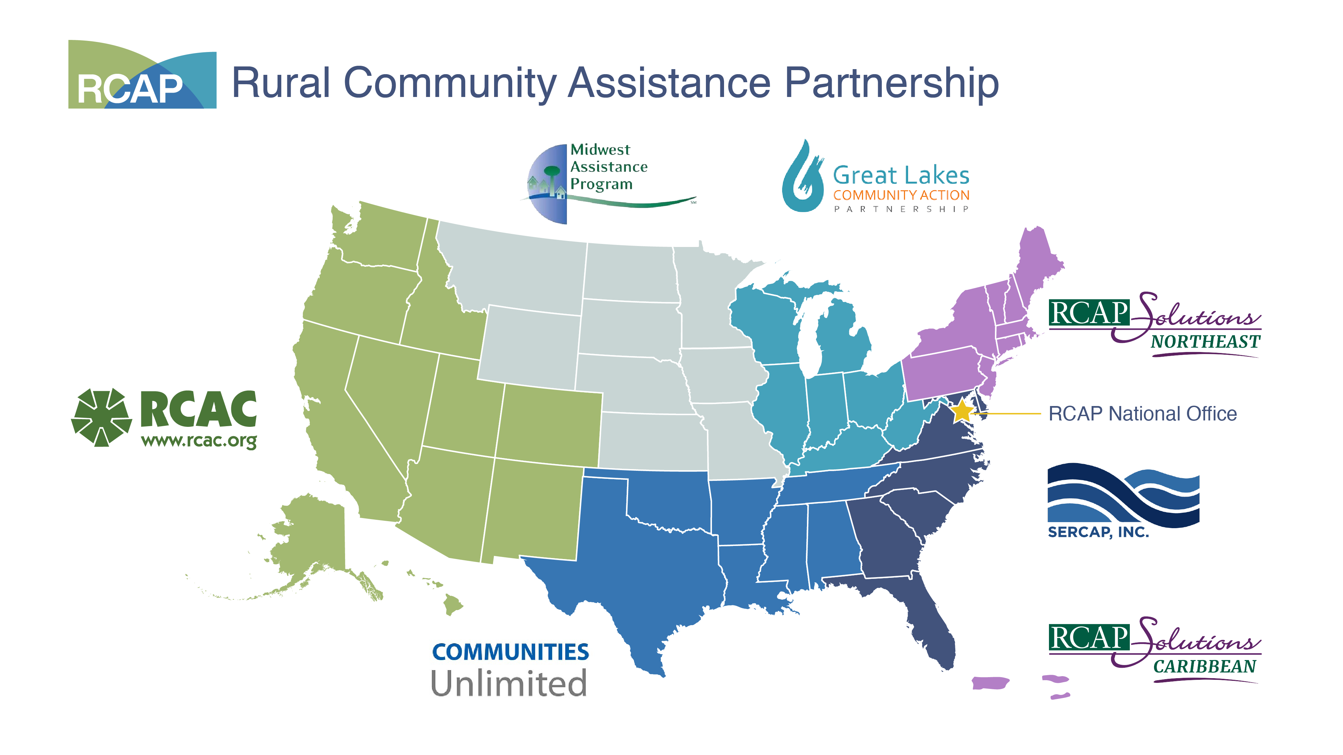
Notes:
This slide introduces RCAP, and you can take a moment to emphasize your region.

Slide 4
Acknowledgement
This project has been funded wholly or in part by the United States Environmental Protection Agency under an EPA Training and Technical Assistance for Wastewater Treatment Works for the Prevention, Reduction and Elimination of Pollution.
The contents of this document do not necessarily reflect the views and policies of the USEPA, nor do they endorse trade names or recommend the use of commercial products mentioned here.
Notes:
This program was funded by a US EPA grant. A standard disclaimer is provided. We have put forth a good effort to not include tradenames. We do not endorse commercial products – we only describe how they operate.

Slide 5
Pre-Test
Question and Answer Cards
Notes:
As people are coming into the event either virtually or in person encourage them to take a the pretest and either write their question down or enter them into the chat function.

Slide 6






Module 1
Overview of Onsite Wastewater
Treatment Systems
Notes:
This is your opportunity to introduce yourself and to introduce the topic. Take a few minutes and ask the participants about their concerns with septic systems, and find out if they have any specific questions about their system that they would like you to address. Have them write the question on a note card (which you provided during registration) and when you are finished with the presentation then you can go to the note cards and start addressing their questions.

Slide 7
Learning Objectives
To understand the function of an onsite wastewater treatment system
Gain knowledge about various types of treatment and dispersal methods
Notes:
Our objectives for this session include gaining an understanding the function of an onsite wastewater treatment system, and to gain knowledge about how the various types of treatment and dispersal methods protect public and environmental health. While our primary audience is rural homeowners who have onsite wastewater treatment systems (i.e., septic systems), this knowledge is also applicable to owners and managers of other rural facilities (schools, churches, commercial, and industrial buildings) that are served by onsite systems.

Slide 8
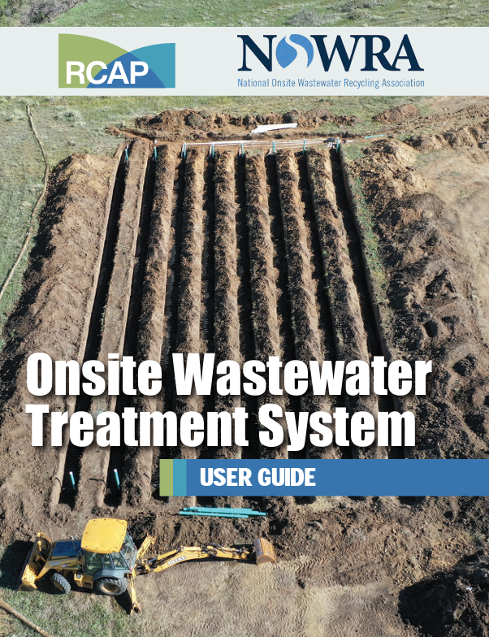
Onsite Wastewater Treatment System (OWTS)
User Guide
  this presentation will supplement the information provided in the User Guide
Notes:
These presentations are intended to supplement the information provided in the Onsite Wastewater Treatment System User Guide.

Slide 9
OWTS Overview
All systems
  collect wastewater
  allow for liquid/solid separation
  remove most of the waste products from the water
  return the water to the water cycle
Notes:
All wastewater treatment systems (whether onsite or municipal-scale) have common features: The wastewater is collected (sewer pipes), solids are separated from the liquid (often called primary treatment on a municipal-scale, contaminants that are dissolved in the water are mostly removed by biodegradation, pathogens are destroyed, and the treated water is returned to the water (or hydrologic) cycle.

Slide 10
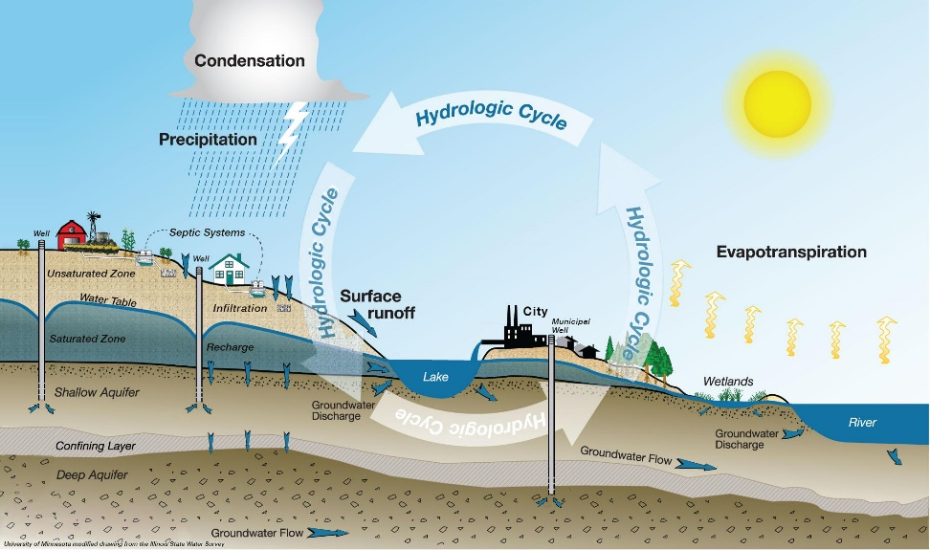
How Big is Your Water Cycle?
Water is continuously recycled
  we depend on our septic systems to return safe water back to the water cycle through
    infiltration
    evaporation
      not always an option
Notes:
Our ultimate goal is to protect public and environmental health. We accomplish this goal by ensuring that the waste compounds we put in the water do not create a negative impact on the next person who uses that water. The time it takes for that water to be used again depends on your location within the water cycle. If your water well is close to your neighbor's septic system, the water cycle may be fairly small. The smallest water cycle is on the International Space Station, where all the water is continuously recycled.

Slide 11
Wastewater Treatment Overview
Pretreatment
  removes most of the solids from the wastewater
  removes about one-half of the organic strength
  prepares the wastewater for soil-based final treatment
Advanced Pretreatment
  provides additional treatment
  for sites that have limiting conditions
    organic strength reduction
    disinfection
    nutrient reduction
Notes:
For onsite wastewater treatment systems, we think about treatment in two basic phases: Pretreatment and Final treatment. Pretreatment prepares the wastewater for final treatment in the soil. It was stated many years ago that the primary purpose of the septic tank is to protect the drainfield. This statement is basically true, but it understates the other benefits provided by the septic tank.
If the ability of the soil is limited in its ability to provide final treatment, the advanced pretreatment can be employed to reduce the wastewater strength before it is applied to the soil. We use the term “strength” to indicate the concentration of contaminants relative to average conditions. We expect that a rural convenience store that serves fountain drinks and greasy fast foods would have a greater concentration of organic compounds (sugars, fats, oils) in the wastewater. This wastewater would be considered high-strength relative to organics. We can provide advanced pretreatment to reduce the strength to a concentration that the soil can treat.

Slide 12
Final Treatment
Final treatment happens in the soil
  the primary purpose of pretreatment is to protect the soil system
  the soil system removes many of the waste products
  returns the water back to the water cycle
Notes:
For onsite wastewater treatment systems that use the soil for final dispersal, the soil provides final treatment. There are billions of hungry microorganisms in the soil that like our wastewater. They break down many of the complex compounds into simpler, less toxic forms, such as carbon dioxide and water.

Slide 13
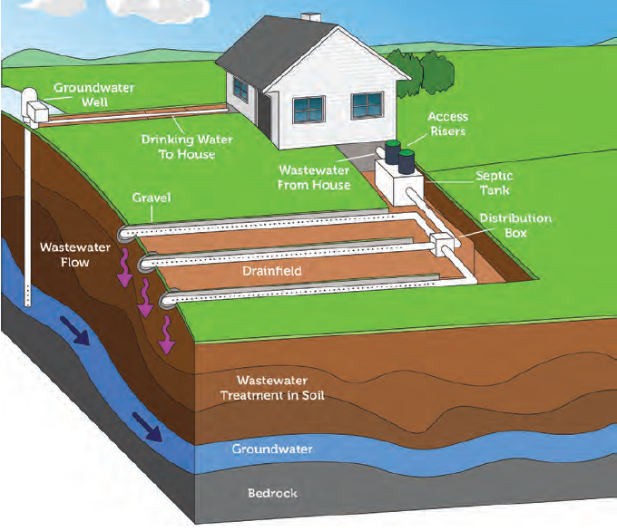
A Conventional Treatment Train
The majority of onsite wastewater treatment systems have this layout
  collection
  septic tank
  soil treatment area
Notes:
The word “conventional” is often used to describe an onsite wastewater treatment system that serves a single residence, the wastewater flows through the system by gravity, and the system consists of a collection network, a septic tank and a soil treatment area.

Slide 14
Notes:
Note: This is a good time to add a local picture or video of a typical system in the area you are training.
There are example photos provided if you do not have any but next time you are in the field great to have a photo or two of your own.
You can add additional photos later in the presentation as needed.

Slide 15
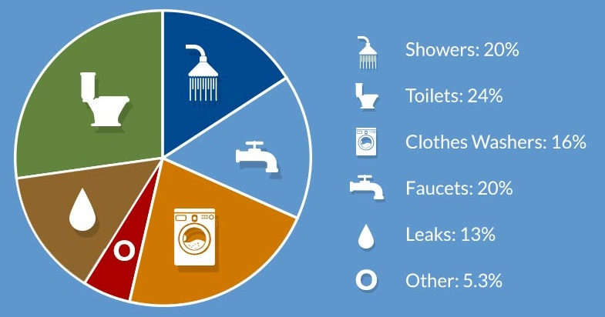
Wastewater Treatment
Begins in the House - Collection
  Blackwater
    toilets
    kitchen sink
    dishwasher
  Greywater
    laundry
    shower
https://www.envirozyme.com/resources/blog/water-pollution-part-2-household-wastewater-treatment
Notes:
Wastewater collection is the first step. The Drain-Waste-Vent system in your house provides this service. Wastewater is then carried out of the house by the Building Sewer that conveys the wastewater to the next component of your treatment system.
What are the ways that we generate wastewater? We bath, we launder our clothes, we wash dishes, and of course, we dispose of the by-products of our metabolism. We often hear the terms Blackwater and Greywater. The terms only become important if we want to think about water reuse. Blackwater is from the toilets, kitchen sink, and dishwasher. This water contains pathogens and the heaviest concentration of other waste products. Greywater will contain more soaps and detergents.
The real focus of this slide is to demonstrate the typical water use in a household. It is often stated that 80% of the water that we bring into the house becomes wastewater. When we water plants, mop the floor and let the water evaporate, wash cars, etc., that water does not become wastewater.

Slide 16
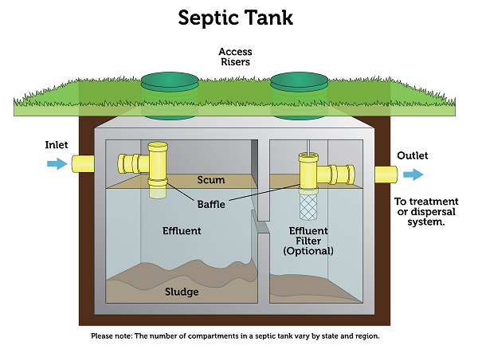
Separating the Solids from the Water
The Septic Tank
  separation is based on density relative to water
    density greater than water
      sinks
      becomes sludge
    density less than water
      floats
      becomes scum
Notes:
For most onsite wastewater treatment systems, the next component is liquid/solid separation.
Many jurisdictions require two compartment septic tanks. The wall between the two compartments reduces the turbulence that occurs when there is a sudden in-rush of water, such as when the laundry machine discharges water into the system. The reduction of turbulence improves the settleability of the solids.
If you are familiar with the septic system rules in the jurisdiction that you're in right now, you might take a moment to discuss how septic tanks are sized based on the number of bedrooms or the flow rate from the source of the wastewater.

Slide 17
Inlet and Outlet Baffles
Baffles help to keep the layers separated
  allows the clarified wastewater to move to the soil treatment area
Wastewater entering the tank
  displaces an equal volume out of the tank
Notes:
The liquid enters the tank through the inlet baffle. This baffle forces the water downward to encourage the settling of solids that are more dense than water. Solids that are less dense than water will rise. Solids that sink become “sludge” on the bottom of the tank. Products that float become the “scum” layer.
If the system is operating properly, the layer of water between the sludge layer and scum layer will have the lowest solids content – the outlet baffle is placed so that only water from this “clarified” zone is allowed to leave the tank.
This is a good time to stress that a septic tank operates on the basis of as water enters the tank, an equal volume of water must leave the tank.

Slide 18
Solids Retained in the Septic Tank
Sludge layer
  some degradation of organic solids
    not all solids are biodegradable
    anaerobic conditions (without dissolved oxygen)
Scum layer
  fats, oils, and grease (FOG), soaps
    fats are from animal sources
    oils are from plant sources
    greases are petroleum-based and come from skin-care products
Notes:
This slide provides a brief description of the waste compounds that are removed by the septic tank. It should be emphasized that these compounds accumulate in the tank and must be removed by having the septic tank pumped out on a frequent basis.
As was described in the previous slide, the heavier solids will sink and form the sludge layer, and the less dense solids will rise and form the scum layer. These products will degrade slowly in the septic tank if they are biodegradable under anaerobic conditions.
This is a good opportunity to talk about fats oils and grease that are part of the organics that are removed by the septic tank. Reinforce that fats are from animal sources, oils are from plant sources, and to be technically specific, grease is a petroleum product which largely enters the septic system from skin care products. This terminology may be confusing for some in your audience because they are accustomed to hearing that grease comes from deep fryers in restaurants, when in fact, it is cooking oil.

Slide 19
Clarified Layer
The outlet baffle prevents the scum layer from leaving the tank
This clarified wastewater is called septic tank effluent
Notes:
The entrance to the outlet baffle is placed in the clarified zone. Some septic tank have an additional screen built into the outlet baffle. The effluent screen provides an extra level of protection to prevent smaller solids from entering the soil treatment area. More about effluent screens later.
The water that passes out of the septic tank is now termed “septic tank effluent.”

Slide 20
Challenging Sites and Uses May Require Advance Pretreatment
Advanced Pretreatment creates a cleaner effluent prior to final treatment and dispersal
  degradation of organic compounds
  disinfection
  nutrient removal
Notes:
As previously mentioned, some homes and businesses can produce wastewater that is too strong for the receiving soil. In these cases, additional pretreatment is added to the treatment system to reduce the strength.
OK, let's reinforce the notion of high strength. Often in our industry high strength refers to organic strength. But that is not a complete thought. High strength is the term used when a waste constituent is stronger or is more concentrated than the typical residential strength wastewater. Some jurisdictions list what is considered to be residential strength. We are not going to discuss numbers in this class, but we'll say if the wastewater is coming from a commercial kitchen, then it is likely that the organic content in the wastewater will be greater than residential strength wastewater.
The additional organic matter has a higher risk of clogging the soil interface. Because of this, we use advanced pretreatment to reduce the organic strength before final treatment in the soil.
Regarding disinfection and nutrient removal, the situation may be that the soil cannot dependably treat the pathogens or the nutrients. So, we may need to incorporate additional treatment (advanced pretreatment) to account for the lack of treatment in the soil.

Slide 21
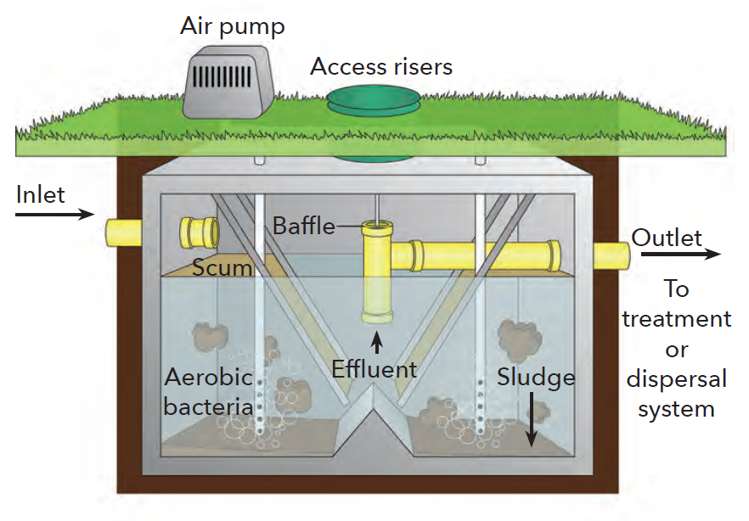
Organic Strength Reduction
Aerobic Treatment Units (ATU)
  aerobic conditions are provided by bubbling air through the effluent
  bacteria digests the organic compounds
    becomes sludge
  some nutrients are removed
Notes:
Often called “ATUs,” aerobic treatment units provide ideal conditions for aerobic (oxygen-loving) bacteria to break down organic compounds. Air, which contains 21% oxygen, is bubbled through the water allowing oxygen to dissolved into the water. The dissolved oxygen supports the bacterial activity. As organic compounds are “oxidized,” these compounds are reduced to simpler forms such as carbon dioxide and water. The bacteria have plenty of food and oxygen and thus reproduce at a rapid rate. Much of the sludge at the bottom of the tank is dead bacteria cells and compounds that are not biodegradable. Because all living cells need nutrients, some nutrients are taking out of the wastewater. However, if the sludge is not pumped out of the ATU on a frequent basis, some of the nutrients will recycle back into the water as the dead cells are degraded.

Slide 22
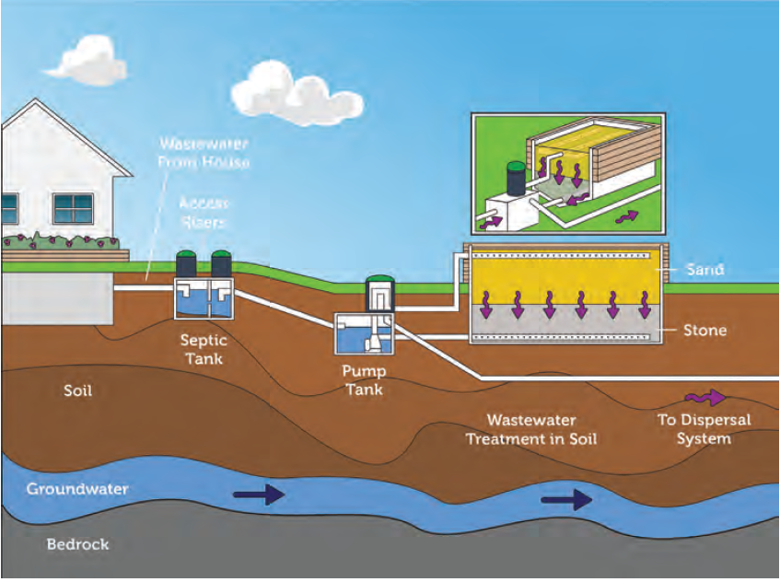
Organic Strength Reduction
Media Filters
  aeration provided as effluent trickles down through the media
  bacteria fixed to the media digest the organic compounds
Notes:
Media filters provide the same aerobic treatment as an ATU. The primary difference is that the bacterial are attached to the media and the wastewater trickles through the media. As the water trickles through the media, oxygen and organic compounds diffuse from the water to the bacteria. This system has the advantage of not needing an air-pump to aerate the water. The disadvantage is that biosolids (sludge) can accumulate in the media. Just as ATUs need to have the sludge removed from the bottom of the tank, media filters may need occasional media cleaning/replacement to keep the system operating properly.

Slide 23
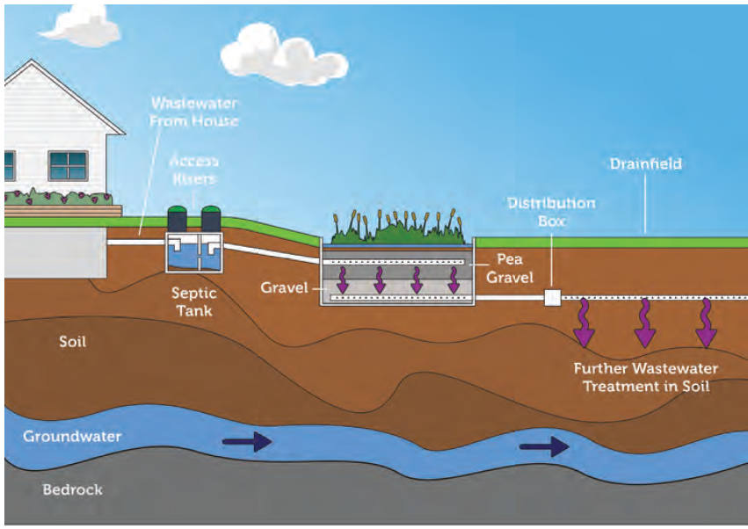
Organic Strength Reduction
Constructed Wetland
  effluent moves just above or just below the media surface
  aeration is provided from the atmosphere and by photosynthesis
  roots also serve as attachment for bacteria
Notes:
Constructed wetlands are another means of providing advanced pretreatment. Wetland plants (plants that can grow in saturated conditions) grow in a media that allows water to flow either just beneath or just above the surface. Because the water is at or near the surface, oxygen can easly difuse into the solution creating aerobic conditions. The plant roots provide a good support for beneficial bacteria to oxidize organic compounds.
Aerobic treatment units are a common method of reducing organic strength, but they are not the only method. Media filters are a second common means of reducing organic strength. We suggest that you cover aerobic treatment units and media filters as advanced pretreatment devices. If you feel that no one in your community has a constructed wetland, then hide the constructed wetland slide.

Slide 24
Disinfection
Destruction of pathogens
  measured as E. coli, fecal coliforms, or total coliforms
  used when there is a greater risk of coming into contact with partially-treated wastewater
  with conventional systems we use the soil for removal of pathogens but not all sites have sufficient soil
Notes:
In general terms, disinfection means the destruction of pathogens, which is different from sterilization – the destruction of all microorganisms. Disinfection is provided when there is a greater risk of human contact before the natural die-off of pathogens occurs. Such cases could include spray dispersal systems, septic systems that are adjacent to lakes, and systems in sandy soils with shallow groundwater. E. coli is used as an indicator of the potential for pathogens. The assumption is that if no E coli are present, then the risk of pathogens is very, very low.
This slide only talks in general terms about the disinfection process. The next two slides provide information about two specific disinfection processes. If you feel that your audience will not be particularly interested in tablet feeders and or ultraviolet light, then you can hide those slides and make the presentation go a little faster.

Slide 25
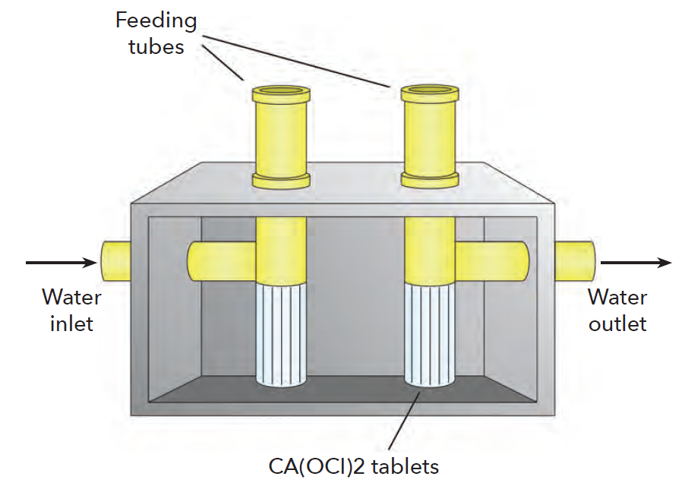
Tablet Feeder
Chlorine
  calcium hypochlorite tablets
  effluent passes through the tablet feeder where chlorine is dissolved into the water
  only used after advanced pretreatment
Notes:
Chlorine is generally the go-to compound for disinfection. A common means of adding chlorine to an onsite wastewater treatment system is to install a tablet feeder. Three-inch diameter calcium hypochlorite tablets are placed in the feeder where the chlorine can dissolve in the water. Addition tablets must be added as the old tablets dissolve
You may get a question about dechlorination, and in general dechlorination is not required for onsite systems because our effluent is going into the soil. Any time chlorinated water is going into a surface water, then dechlorination is required. Dechlorination systems operate bypassing the water through sulfur dioxide. Onsite systems are available that can provide chlorination and dechlorination with a single piece of equipment. However, this is only required when you have a direct discharge.

Slide 26
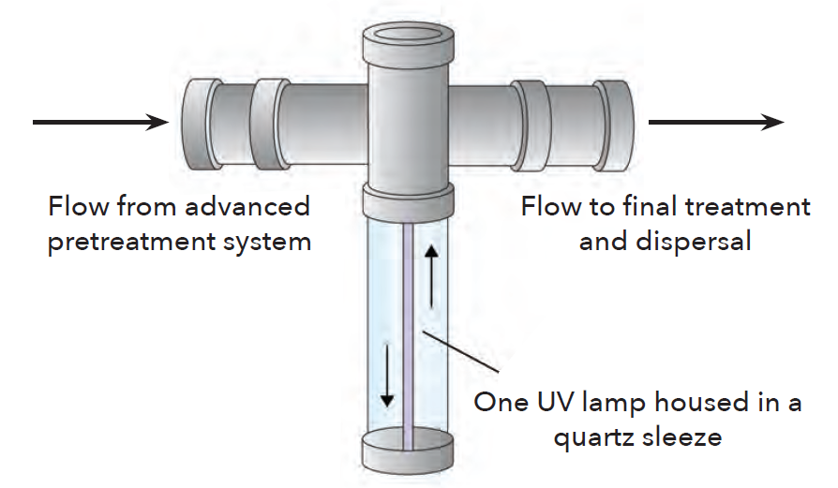
Ultraviolet Light (UV)
UV light damages the DNA, bacteria cannot reproduce
  effluent passes through a chamber that is illuminated with UV light
  only used after advanced pretreatment
Notes:
Ultraviolet light (UV) is a second common method of providing disinfection at onsite wastewater treatment systems. A UV light produces a light with a wavelength of approximately 200 to 280 nanometers (nm). The optimum germicidal value is 254 nm. This light wave damages the bacteria’s DNA, preventing them from reproducing.
Your audience may be interested to know that the lamp needs to be replaced approximately once per year. The electrical cost is very low. These devices consume the same amount of electricity as a small fluorescent lamp.

Slide 27
Moving Between Treatment Components
Where possible
  OWTS are based on gravity
  each component is at a slightly lower elevation than the previous one
Sometimes
  pumps are added when we need to lift wastewater to the next component
  assist with uniform distribution
Notes:
Water flows downhill and gravity is the least expense way to move wastewater. Not every homesite has sloping ground, and sometimes the best soil for the final treatment is at a higher location. Lift pumps are used to move water uphill. A second application for pumps is to provide the water pressure for pressurized distribution systems – which will be discussed in a few minutes
This slide is a transition between pretreatment and final treatment. It allows you to talk about pump systems if you feel it is germane to your audience. If no one in your audience has a pump as part of their onsite system, then you may choose to hide the next series of slides dealing with pumps and controls.

Slide 28
Pumps, Pump Tanks, and Controls
A pump system generally consists of a
  pump tank
    usually sized to hold a two-day wastewater volume
  dose pump
    to transfer the contents to the next component
  controls
    to activate/deactivate pump, sound alarm
Notes:
A pump requires a pump tank, a pump, and controls. The pump tank allows for the accumulation of effluent so that the pumps does not have to operate all the time. Typically the tank is sized to hold a volume equivalent to two-days of water usage. This volume allows for the time needed to repair the pump system in case of failure. Most pump systems have a high-water alarm to notify the owner if the pump has failed.
Some type of device is needed to power on and then power off the pump. Most commonly, a float (or floats) is/are used to activate the pump. These controls should be placed in a control box located near the pump tank.

Slide 29
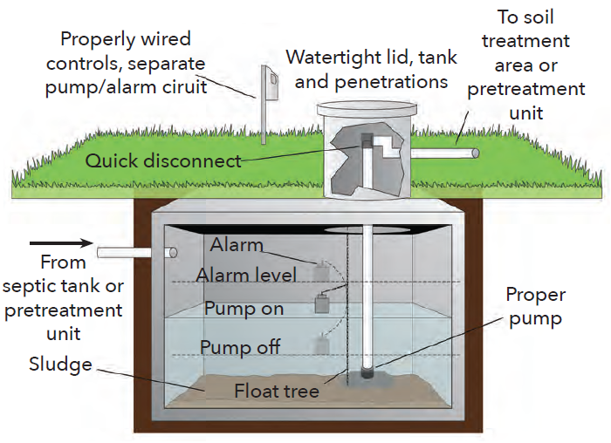
Pump Tank
Accumulates wastewater until the next pump cycle
  pump will activate at preset time or preset fluid level
  must have access from surface
Notes:
The pump and controls are maintenance items and must be accessible from the surface. All items associated with a pump system have maintenance requirements. As such, please reinforce that the pump system must be accessible for maintenance and repairs.

Slide 30
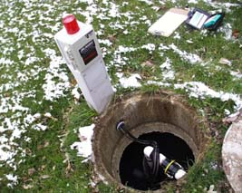
Pumps
Submersible pumps
  fractional horsepower
  minimum power consumption
  typically, last 7 to 10 years
Notes:
The typical wastewater lift used for onsite wastewater treatment is submersible and is less than 1-horsepower. This means that they do not need to be primed, and there is minimum electric power consumed by the pump system.

Slide 31
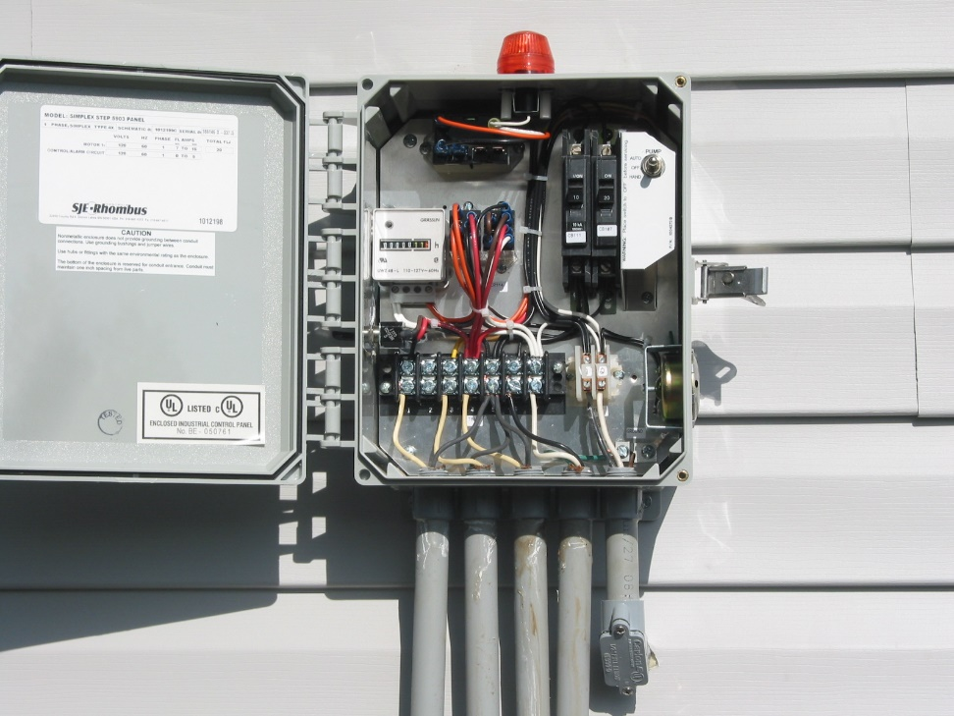
Controls
Floats and timers
  floats indicate the fluid level in the tank
  activate/deactivate pump as needed
  panels can provide information about pump operation
Notes:
The controls should be in a weather-proof control panel. Most pump systems have one or more floats (to activate the pump and to activate the alarm), the electric leads from the floats should terminate in the control panel. Although not usually required, it is strongly recommended that pump control system include a pump timer, and event counter to provide information about the operation of the pump.

Slide 32
After Pretreatment, the Effluent moves to Soil-Based Final Treatment
The soil is a very powerful wastewater treatment system
  biological properties
  chemical properties
  physical properties
The soil must allow for water movement
Notes:
The soil is the ultimate wastewater treatment system. Municipal and onsite scale systems are engineered devices that try to mimic the soil. However, the soil must be able to pass the water. The first step in determining the suitability of a soil for final treatment is to determine the rate by which water can move through the soil. Most locations no longer use the percolation test to make this determination, rather, trained soil evaluators look at the texture, structure, depth of the soil to determine its ability to move water and provide final treatment.

Slide 33
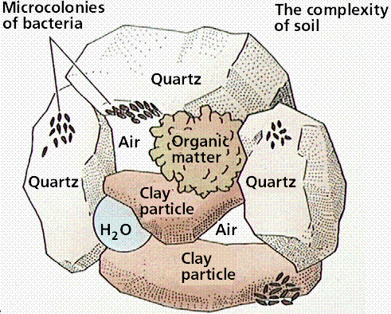
The Soil is a Complex Media
A suitable soil allows
  biodegradation
  nutrient conversion
  binding with minerals
  plant uptake
  deep percolation of water
Notes:
The soil supports microorganisms that can degrade organic compounds, contains inorganic compounds that can bind with phosphorus, has porosity so water and air can move, and allows for the plant uptake of other nutrients.
You can discuss the activity in the soil to your comfort level. This slide and the picture on the slide do a pretty good job of describing what goes on in the soil for the renovation of the effluent.

Slide 34
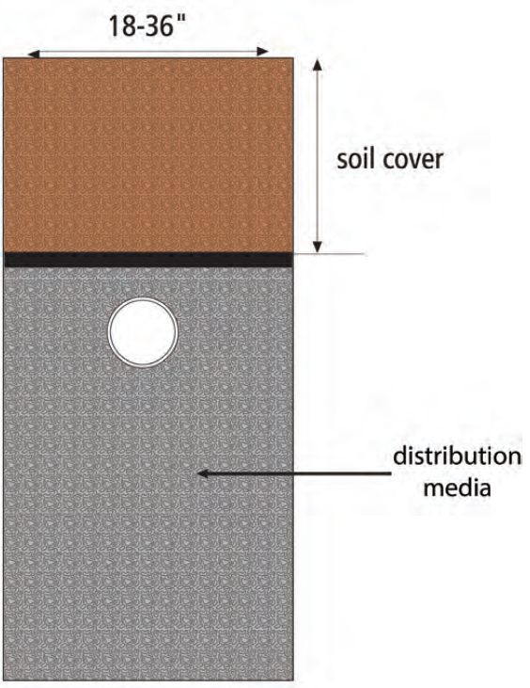
Applying Effluent to the Soil
Trench-base dispersal
  gravel or other media provides storage when effluent inflow is greater than infiltration into soil
Infiltrative surface
  mostly on trench bottom
  some infiltration on sidewalls
Notes:
Soil-based wastewater treatment systems use trenches or other types of excavations to place effluent in the subsurface soil. A trench refers to an excavation that is 2 to 3 feet wide and is partially backfilled with a media that provides porosity, or an open void that allows for the storage of effluent. This storage is needed for times when the inflow of water to the trench is greater than the outflow by infiltration into the soil.
Depending on your familiarity with onsite systems and the various trench configurations that are available in your jurisdiction, you can choose how much you want to talk about the various trench configurations. The configurations refer to the various media that can be placed in the trench to provide storage. Historically, gravel was the most common trench media. However, modern materials, mostly constructed out of durable plastics, are becoming more common. These materials provide storage by holding open volumes in the soil so that when effluent leaves the septic tank at a rate greater than the infiltration rate, there is storage in the trench until the effluent can infiltrate into the soil.

Slide 35
Dispersal into the Soil
Provides separation between humans and our wastes
  public health
Provides a means of preventing our wastes from becoming an environmental contaminant
  environmental health
  natural means of renovation
Notes:
By placing the effluent in the subsurface environment, we are putting a barrier between us and our wastes (public health) and placing our waste in a location where renovation can take place, thus protecting environmental health.

Slide 36
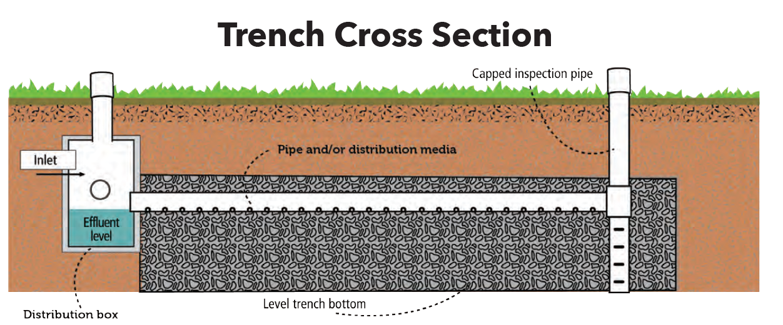
Common Dispersal Methods
Gravity
Pressurized
Spray
Combined treatment and dispersal
Notes:
The common styles of applying effluent to the soil include subsurface gravity, subsurface pressurized, above the surface spray distribution, and systems that provide both additional treatment and dispersal in the subsurface.

Slide 37
Conventional Septic System
Gravity Distribution
  effluent enters trench
  moves by gravity to distal end
  poor distribution uniformity
  least amount of maintenance
Notes:
Most onsite wastewater treatment systems are considered conventional. This means that water moves between components and through the soil treatment area by gravity. These are trench-based systems where effluent enters one end of the trench and moves to the opposite end. Effluent is continuously infiltrating along the trench length, and so more infiltration takes place near the beginning of the trench. As more effluent enters the soil, there is an increased accumulation of biological materials (a biomat) that limits the infiltration rate. As the biomat forms and the infiltration rate is reduced, water can move further down the trench for rapid infiltration. Because water can only enter the trench from one location, that location does not get an opportunity to dry out.
Conventional septic systems are the most common means of applying effluent to the soil. The next series of slides demonstrates other methods of effluent application. Once again, if you feel that these additional slides are not pertinent to your audience then go ahead and hide the slides so you don't have to cover the material.

Slide 38
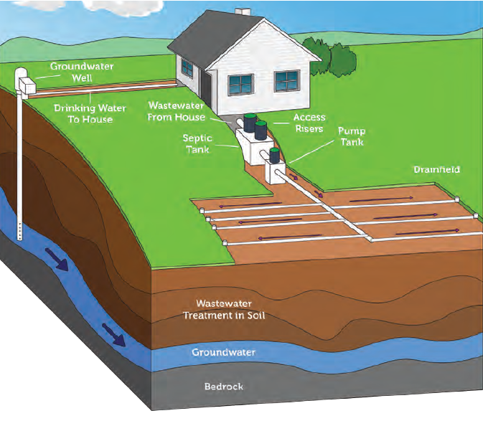
Low Pressure Pipe System
Pressurized distribution
  provides good application uniformity along trench length
  operates at approximately 7 psi
  need pump tank, pump, and controls
Notes:
A low pressure pipe system is the solution to the poor distribution found in a conventional system. This system still has a trench system and a media that provides more storage in the trench. A pipe, typically 1-1/2 inch diameter PVC is placed in the trench. This pipe has small perforations (3/16 inch is typical) spaced every 60 inches. These perforations (or orifices) distribute water along the entire length of the trench. This is a pressurized system, so a pump or a dosing syphon is needed to provide the pressurization.

Slide 39
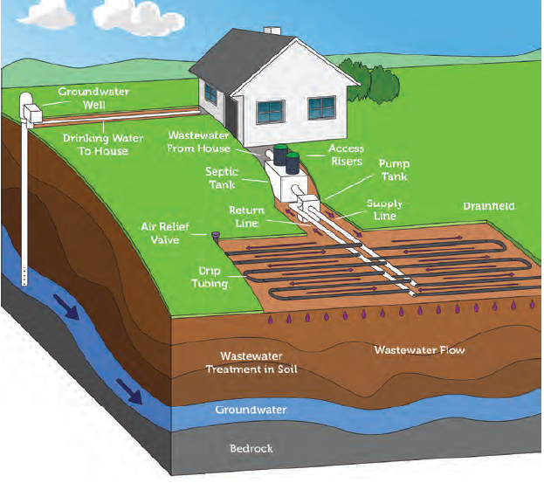
Drip Distribution System
Drip irrigation technology
  slow, precise application
  often used in less permeable soils
Pressurized system
  filter, pump and controls
Notes:
For some sites with limiting soil conditions, a distribution system to use drip irrigation technology may be a solution. With is technology, some regulatory jurisdictions will allow less-than-suitable soils to be used for final treatment. The drip system provides a precise application of effluent to the soil. A drip system requires filters to be installed just after the pump. This technology requires maintenance.

Slide 40
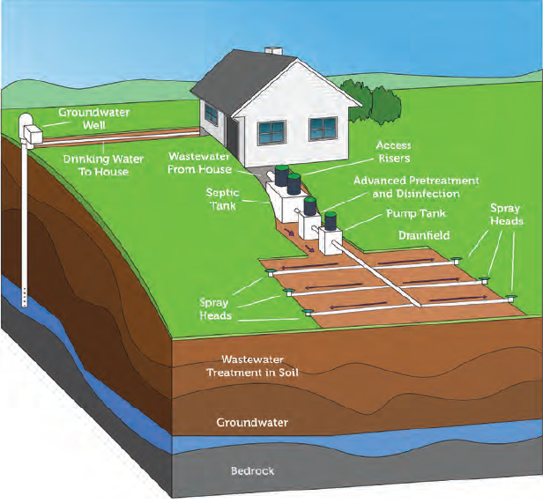
Spray Field
Can provide excellent application uniformity
Because of risks
  must be properly managed with disinfection
  spray field should be fenced
  spray at night
Notes:
Spray irrigation is another means of allowing a less-than-suitable soil to be used for final treatment and dispersal. Not all regulatory jurisdictions will allow spray because of the increased risk to public health. Pop-up sprayers are commonly used. At locations that allow spray dispersal, most require the effluent to be disinfected, the spray field is fenced, and spraying takes place at night.

Slide 41
Combined Treatment & Dispersal
In low permeability soils,
  there is a risk that organic compounds and biosolids will clog the infiltrative surface at the bottom of the trench
Likewise,
  in shallow soils, additional treatment that the soil cannot provide may be needed
These dispersal system modifications can provide that extra treatment
Notes:
Combined treatment and dispersal systems provide additional treatment in the subsurface environment. Often used in low permeability soils where the addition of organic matter and solids from the wastewater could further reduce the permeability, these system help to extend the life of the infiltrative surface.

Slide 42
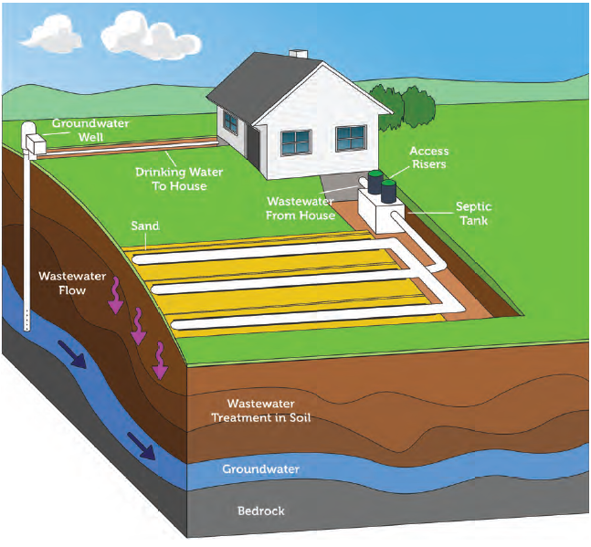
Sand-Lined Trenched
In-trench media filter
  provides additional treatment in the trench
  air moves through sand allowing aerobic conditions
  attached bacteria growth on the sand
Notes:
Sand lined trenches provide a very similar treatment mechanism as media filters. Effluent is distributed along the length of the trench. The effluent trickles through the media under aerobic conditions. This provides additional organic compound removal, some nutrient transformation, and additional solids filtration.

Slide 43
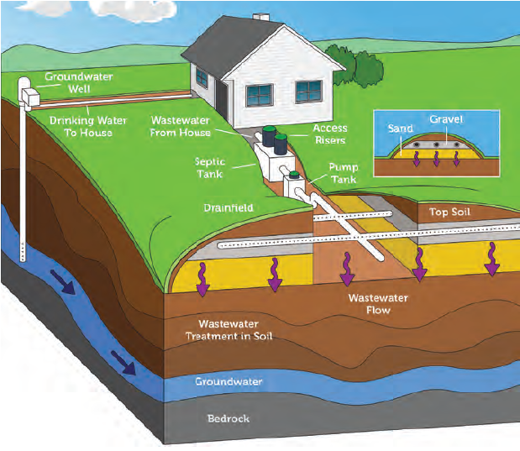
Mound Systems
Provides treatment by trickling effluent through media
  water clarification
  organic removal
  limits potential for soil clogging
Used at sites with shallow soils
Notes:
Mound systems were the original combined treatment dispersal system. In order to get additional separation from a limiting layer (groundwater, bedrock, or heavy clay), mounds of sand are raised, and effluent is allowed to trickle down through the media. These mounds are covered with native soil and planted in native vegetation.

Slide 44
Non-Soil Based Dispersal/Disposal
In locations where conditions allow, there are other means of returning effluent back into the water cycle
  evapotranspiration beds
  lagoons
  direct discharge
Notes:
There are non-soil based dispersal systems that return effluent back into the water cycle.
As before, if these systems are not available to your audience, then hide these slides.

Slide 45
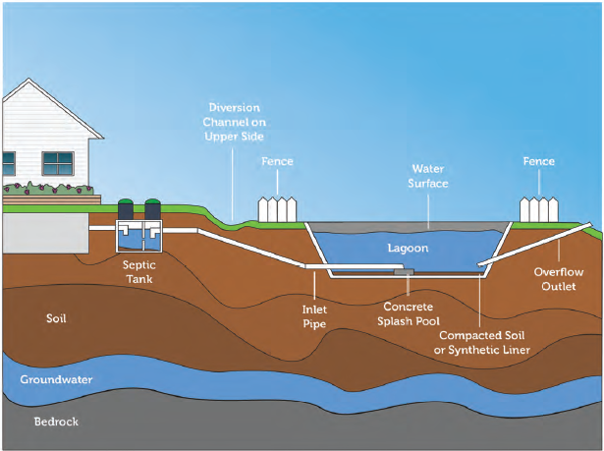
Lagoon System
Provides Treatment
  aerobic near water surface
  anaerobic in deeper water
Holds effluent during dry season
  discharges during wet season when dilution water is available
Notes:
A few regulatory jurisdictions allow lagoons for residential onsite treatment systems. Lagoons have long retention times, allowing the slow treatment of effluent. The typical practice is hold the effluent during the dry season and then release the effluent during the wet season when there is plenty of dilution. At locations that allow lagoons, it is typical for the regulatory agency to require the homeowner to have 5 or more acres to provide a significant buffer from the neighbors.

Slide 46
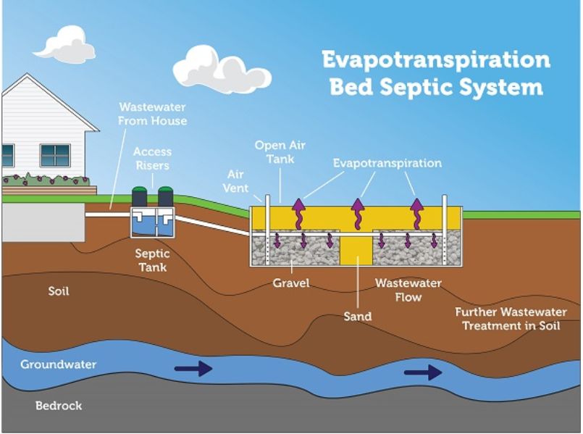
Evapotranspiration Beds (ET)
Water goes into the gas phase
  through plants
    transpiration
  from liquid water
    evaporation
Dry climates only
  ET must be much greater than precipitation
Notes:
In areas with there is more evapotranspiration (ET) than precipitation, ET beds can be a viable option.

Slide 47
Direct Discharge
Effluent is discharged in a surface water
Very few OWTS are allowed to direct discharge
  requires extensive regulatory permitting
    National Pollutant Discharge Elimination System (NPDES) permit
  requires extensive treatment before discharge
    samples must be taken to ensure permit compliance
Notes:
Any direct discharge to a surface water must have a National Pollutant Discharge Elimination System Permit (NPDES). Systems that direct discharge must be in compliance with the permit limits. These are high maintenance, and high risk systems.

Slide 48
Wrap-Up
We have reviewed how onsite wastewater treatment systems operate
  collection, pretreatment, final treatment
And, we evaluated the various methods used to disperse effluent into the soil
  and how these methods allow for different climates and soil conditions

Slide 49
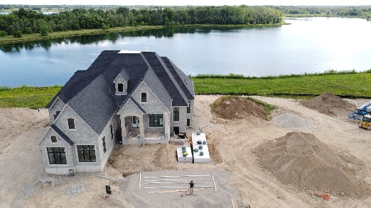
Questions
Basics of Onsite Wastewater Treatment
Notes:
Type your name and contact information onto this slide.
If you get a question that you are not comfortable answering, then say “you do not know the answer.” But, after the class, get the person’s contact information and question so that you can contact a local or national expert on that topic. The first place to go with questions should be the local jurisdiction that regulates septic systems.

