Slide 1
Module 3
Home Management Tips
Notes:
These training materials were developed by Sara Heger (sheger@umn.edu) and John Buchanan (jbuchan7@utk.edu). Please email with questions, edits, or needed additions.
Add regional, organization, or company logo in the picture frame in the center.
Note: Modify the presentation to fit the systems and community you are providing training for along with the time available.

Slide 2
Learning Objective
Implement changes in your home to reduce the load to your OWTS
Notes:
OWTS need to be managed to operate properly. System management is the understanding of how the system works, knowing where the components are located, and realizing that regular maintenance is required. There are components that will wear out and need replacement and there are components that will fill with non-degradable solids that need to be removed. It is critical to understand that all properly operating systems need management to serve as a long-term solution. These activities are straightforward, necessary, and time sensitive for systems to operate properly.

Slide 3
Wastewater Sources and Usage
DeOreo et al. (2016)
Notes:
When we bathe and launder our clothes, water dissolves the sweat and soil and rinses those compounds down the drain. When we flush the toilet, water is used to transport the by-products of our metabolism out of the house. The primary objective of your OWTS is to remove the waste from the water. Proper treatment of sewage recycles water back into the natural environment with reduced health risks to humans and animals and prevents surface and groundwater contamination.

Slide 4
Wastewater Estimates and Generation
Residential systems typically use bedrooms to predict maximum occupancy/use
Assuming two people per bedroom, most regulatory agencies specify a hydraulic loading rate in the range of 100 to 150 gallons per day per bedroom
Try to conserve water
Based on annual estimates of actual use
Per person per year = 27,000 gal/year
Typical home ~ 3 persons = 58,000 gal/yr
250 homes in an area = 14.5 million gallons/year
Notes:
Note: The sizing on the left should be adjusted for local regulations. On the right you could update the home number based on the size of the town/community you are working in.
Using 150 gallons per day per bedroom as an example, then the hydraulic loading rate for a three-bedroom home is 450 gallons per day. Again, this is not an average water usage –it is an infrequent daily usage, such as when we wash four or five loads of laundry in the same day.
The total amount of water and the pattern of water use affect how well the OWTS performs and how long it will last. . Property owners should be conservative with their water use and time out water usage throughout a day and week whenever possible.
A lot of water goes through our systems with the average person using 27,000 gallons per day and a typical household using 58,000 gallons. Within a small community of 250 homes that will equate to 14.5 million gallons annually.

Slide 5
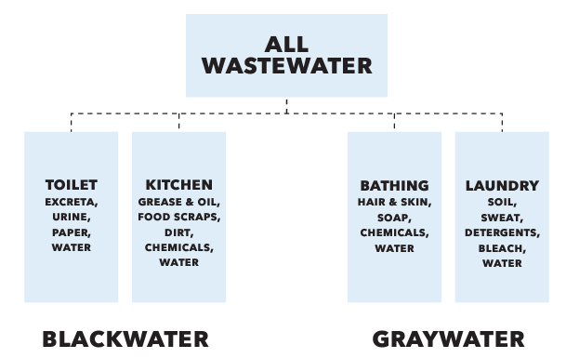
What is added to the water?
Pathogens
Virus, Bacteria
Solids
Organic
Inorganics
Nutrients
Phosphorus
Nitrogen
Chemicals
Cleaning products
Water treatment
Medications
Notes:
Sewage from our home contains four primary groups of contaminants that must be removed to effectively protect public and environmental health.
•Pathogens—harmful viruses and bacteria
•Solids—organic and inorganic material
•Nutrients—nitrogen and phosphorus
•Chemicals—cleaning products, personal care products, medications, etc.

Slide 6
Tips to lessen the load for septic system longevity
Notes:
Now we will go through your home and discuss ways to reduce your impact to OWTS.

Slide 7
EPA Video – Don’t Strain Your Drain!
Notes:
In this video "Don't Strain Your Drain," learn about the importance of using water efficiently, staggering water use of water based appliances, and using energy efficient appliances.

Slide 8
General Recommendations
Listen for drips and leaks and fix all internal pumping leaks
Choose appliances that offer water and energy efficient cycles
Do not use your toilet or septic system as a garbage can – place this waste in the garbage
Limit the use of harsh cleaners and sanitizers as they kill benefital bacteria in the OWTS
Use products that are natural/biodegradable
Look up products that get an “A” www.ewg.org/guides/cleaners/
Notes:
For complete and uniform treatment of waste, the system needs time to work. The ideal situation would be to have sewage enter the system as evenly as possible throughout the day and week. Allowing faucets to drip, fixtures to leak, and continually running water to wash and rinse dishes, shave, and brush teeth are wasteful water habits that contribute to extra wastewater entering the OWTS.
One of the best ways to reduce the amount of water needing to be treated by the OWTS is to replace old water-using appliances. Look for WaterSense (epa.gov/watersense/watersense-products) labeled products which are backed by independent, third-party certification and meet EPA’s specifications for water efficiency and performance.
Choose biodegradable, nontoxic and hypoallergenic products when possible and limit or eliminate the use of antibacterial soap/cleaners.

Slide 9
EPA Video: Don’t Overload Your Commode!
Notes:
In this video, "Don't Overload the Commode," learn about what can be flushed down the toilet, and what should be thrown in the trash.

Slide 10
Bathroom Recommendations
Toilet is #1 water user in a homes (24%)
Replace old 5+ gallon flush toilets with low or dual flush toilets to use 1.6 gallons per flush or less
Fix leaking problems
Typically, a simple gasket that if not replaced can add 100s of gallons of water per day
Notes:
Old style five-gallon flush toilets are the #1 water-using devices. Utilizing low flow or dual flush toilets can make a significant difference. Repair leaky faucets and toilets immediately as these can add ten to hundreds of extra gallons to your system per day.

Slide 11
Bathroom Recommendations Cont’d
Many toilet cleaners are very hard on OWTS
Do not use automatic sanitizers
Small amount with “elbow grease”
Only put human waste and toilet paper in the toilet
No kleenex, q-tips, cigarettes, hair, cotton balls, wipes, condoms, feminine products, unused medication
Notes:
Do not use “every flush” toilet bowl disinfectants that are placed in the tank or bowl as they add a continual dose of sanitizer to your system which kills good and needed bacteria.
The only waste aside from human that should enter the bowl is toilet paper as all other solids will not break down. Use moderate amounts of toilet paper that break up easily in water.
Do not flush facial tissues, sanitizing wipes, paper towels, cigarette butts, condoms, or personal hygiene products down the toilet.

Slide 12
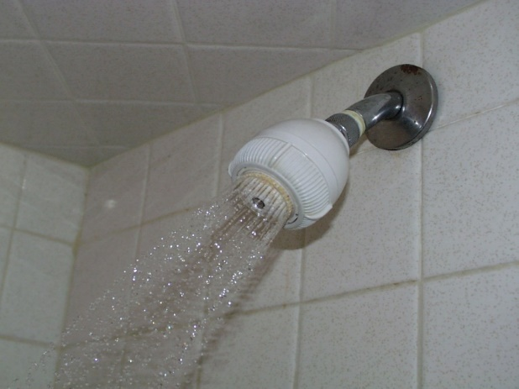
Bathroom Cont’d Bathing
Take shorter showers versus baths
Use low flow fixtures (< 2 gpm)
Avoid daily cleaners
Daily cleaners are hard on system
Avoid anti-bacterial soaps
They are no more effective than regular soap
The less soap and cleaners the better
Notes:
Bathing and handwashing are the second biggest use of water, so installing low-flow shower heads and faucets is a great idea. Take short- to moderate-length showers instead of tub baths. Showers use less water than tub baths as there are five gallons or more per inch in a tub.
Avoid anti-bacterial products as they will harm the natural bacteria needed to treat the wastewater.
Bar soap is recommended over liquids to minimize the amount used.

Slide 13
Clearing Clogged Drains
Use adequate strainers in all drains from sinks, showers, tubs, laundry, etc.
Inexpensive metal or plastic drain screens
When drains do plug, it’s usually in trap below sink
Take it apart, use a plunger or snake
Majority of products sold to clear drains will damage the microbes in your OWTS
Notes:
Do not use drain cleaners to remove clogs as they are typically very harmful to natural good bacteria needed in your OWTS.
If the drain slows down due to build up, clean with a plunger or plumber’s snake instead of using a chemical-based solution.

Slide 14
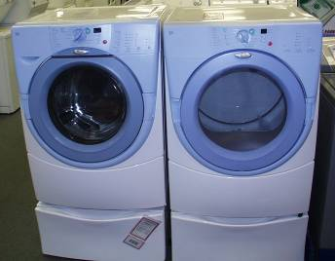
Laundry Recommendations
Install front loading machines
65% less water
12 – 20 gallons
Less electricity to dry clothes
Spread out FULL loads
think even
throughout week
throughout day
Notes:
Select a front-loading washing machine, which will use 40% to 65% less water, and/or use a water/suds-saving or highly efficient top-loading washing machine to reduce water and detergent use. Wash only full loads or be sure to adjust load level settings for small loads. Distribute wash loads evenly throughout the week to avoid overloading the system with large volumes of water in a short period of time.

Slide 15
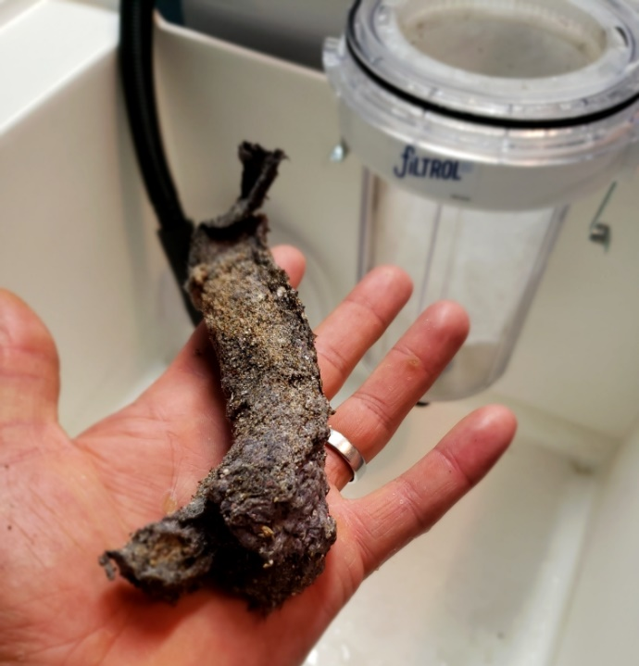
Laundry Cont’d
Add a washing machine lint filters:
Washing clothing release a lot of lint much of which is inorganic
Options:
Simple screen on discharge line
Purchase and install an after market lint filter
Notes:
More lint comes off in washing clothes than drying and much of this lint is very small particles that may not settle out in your septic tank. More of the clothing we are wearing is made of synthetic materials (fleece, spandex, nylon, etc.) and these fibers are inorganic and the microbes can’t break them down.
Very few washing machines have a filter but owners could look for one or install an after-market filter on the washer and dispose of the lint in the garbage.
Picture shows lint removed from the filter in the background.

Slide 16
Laundry Cont’d
Limit bleach and other sanitizing products (less than 1 load/week)
Limit detergent to the minimal amount needed to get clothing clean
Inexpensive powders contain clay as a filler
Do not use liquid fabric softeners
May prevent natural 3-layer stratification from occurring
Recommendations:
Add a ½ cup of baking soda or vinegar or both
Drier balls
Anti-static - aluminum foil ball
Notes:
Use laundry detergents that do not contain phosphates or are labeled as sanitizing.
Use the minimum amount of detergent or bleach necessary to do the job – start with ½ of the manufacturer’s recommendations as they are in the business of selling product and particularly with soft water and low water use washing machines not much soap is needed.
Select natural-based, biodegradable detergents that do not contain clay that can clog up downstream components.
Avoid the use of liquid fabric softeners as they can impact how your septic tank and other components operate instead use natural products or drier balls.

Slide 17
Kitchen Recommendations
Run FULL dishwasher or fill the sink to wash dishes
do not let water run
Detergents - Choose phosphate free
Sink:
Scrape plates into compost/ garbage
Fix leaks
Fats and oils are solid waste!
Thaw food in refrigerator versus under running water
Eliminate or reduce the use of a garbage disposal/ grinder
Adds more solids
Undigested food is harder to break down
Chopped into small pieces which do not settle out as well
Notes:
A full dishwasher uses less water than using the sink.
Choose non-phosphorus (P) based cleaners as excess P in fresh waters can cause algal blooms.
Limit the amount of food particles that enter your system to minimize the load to the system. Do not use a garbage disposal or dispose of vegetables, meat, fat, oil, coffee grounds, and other undigested food products in the OWTS as it is better to either compost or handle with your garbage service. The food waste from the sink is much harder for the bacteria to break down and when ground up may not settle well in the septic tank.

Slide 18
Video from EPA – Think at the Sink!
Notes:
In this video, "Think at the Sink," learn what not to put down your kitchen sink (such as fats, oils, or greases), how to properly dispose of food waste, and how to use cleaning supplies in moderation.

Slide 19
Utility Room Recommendations
Do not allow clean water from sump pumps or tile lines to drain into system
Do not run water to prevent a system from freezing
Consider routing other uncontaminated sources out of your system such as furnace condensate, dehumidifiers, water treatment devices (water softeners, iron filters, reverse osmosis)
Notes:
In your utility room, consider rerouting the water softener and ion filter recharge water outside the OWTS. Recharge the water softener as infrequently as possible to reduce water use. Dispose of all solvents, paints, antifreeze, and chemicals through local recycling and hazardous waste channels. Consult local solid waste officials for proper methods. These materials kill valuable bacteria in the system and may pass through to contaminate drinking water. Never let wash water from latex paint on brushes or rollers go down the drain and into the OWTS. Neutralize condensation in high efficiency furnaces due to its acidity or route away from the OWTS.

Slide 20
Hazardous Waste
Can not go into your system so find a hazardous waste drop off
Unused medicine drop off
fda.gov/drugs/disposal-unused-medicines-what-you-should-know/drug-disposal-drug-take-back-locations
Notes:
Do not place hazardous waste, painting cleanup or other harsh chemicals down the drain. This includes: Paints, Adhesives, Aerosols, Cleaners, Drain Cleaners, Antifreeze, Automotive fluids, Used Oil, Gasoline, Herbicides, Pesticides, Pool chemicals, Hair Spray, Perfume and cologne.
Dispose of unused medications at an authorized drop off facility. Locations can be found using the FDA link provided.

Slide 21
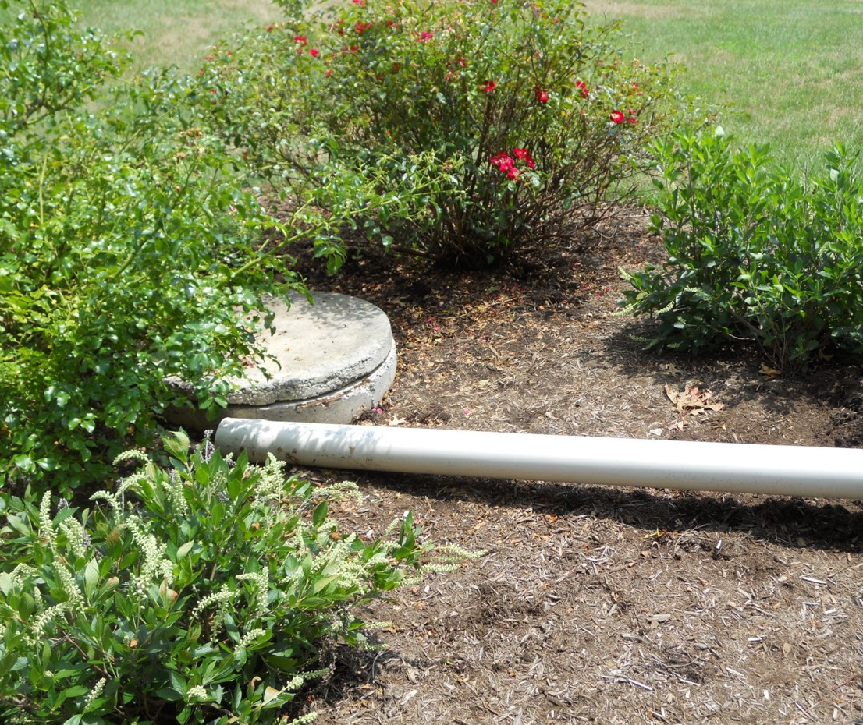
Outside the Home Recommendations
Assure no treated water from hot tubs or pools enter the OWTS
Route roof drains away from the OWTS
Do not park vehicles over the OWTS
Notes:
Outside your home be sure to route chlorine-treated water from swimming pools and hot tubs to not drain into or around your OWTS both the volume of water along with the chemicals could harm your OWTS
Route roof drains and basement drainage tile water (sump pumps) away from OWTS to avoid overloading the system
Nothing larger than a riding lawn mower should traffic over your system to protect underground components and to assure the area is not compacted so pores are open for water and air movement.

Slide 22
EPA Video – Shield Your Field!
Notes:
In this video, "Shield Your Field," learn about your septic system’s drainfield, including how it works, and tips to take care of it.

Slide 23
Landscaping Considerations
Do not irrigate or fertilize over the OWTS
Do not drive anything larger than a riding lawn mower over your OWTS
Do not grade or add soil over the system without consulting the Installer/Permitting authority
Notes:
If the correct vegetation is planted, watering is only necessary Landscaping and Land Use Near Your Onsite Wastewater Treatment System within the first few weeks after planting. Once the vegetation is established, it needs to be watered only when the vegetation shows extreme signs of stress. STA areas receive hundreds of extra gallons of water per day during rain events, and the added moisture of excessive watering or irrigation could stress the septic system. All surface drainage should be directed away from septic system components. Fertilizing over the STA is not advisable as human wastewater contains significant amounts of nitrogen and phosphorus and fertilizing may cause over-accumulation or leaching of the nutrients.
Driving heavy equipment over system can damage components and compact the pore space in the soil needed for oxygen transfer and water movement.
Grading may change the flow of surface water over and around the system and the weight of equipment could damage the system.
Adding soil may reduce the oxygen transfer to the soil.

Slide 24
Vegetation Do’s and Don’ts
Do’s
Don’ts
Do establish vegetation to protect the system from erosion and freezing
Do use native drought-tolerant plants on and near the soil treatment area
Do frame the system with dwarf trees and shrubs at a distance
Don’t plant edible plants such as vegetables and herbs over the system
Don’t place trees and shrubs on the soil dispersal system or near other components
Don’t place plastic landscaping sheets over the soil treatment area
Notes:
Note: adjust slide if freezing is not relevant.
Good vegetative cover—usually grasses, wildflowers or groundcovers—should be planted over the soil treatment area and mowed or weeded as needed.
The vegetative cover helps the system remove nutrients such as nitrogen and phosphorus by using them for plant growth and, in cold climates, it will help to insulate the system.
Vegetable gardens should not be planted in the STA as disturbing the soil with these annual crops is not good for the septic system and most vegetable gardens need frequent irrigation.
Any woody perennial including bamboo, vines (wisteria, bittersweet, morning glory, campsis and hops), shrubs (low, woody perennial plants 3-15 feet in height) should not be planted on top of the STA, but can be planted with caution within 5-10 feet of the edge of the system.
Plastic landscaping will prevent oxygen from getting to your system.

Slide 25
Vegetation Recommendations
Avoid
Choose
Avoid thirsty plants that set deep roots
Avoid planting aggressive dense ground covers that will interfere with the evaporation process
Drought tolerant plants
Plants with short, fibrous root systems
Hardy/tolerate of your climate
Tolerant of sun and shade conditions
Notes:
Do not place trees or shrubs on the septic system; roots may invade the piping and cause damage or blockages. Water-seeking trees such as poplar, birch, beech, walnut, maple, willow, linden and elm should be planted at least 50 feet from the STA. The rule of thumb is to keep a distance equal to the anticipated height of the tree at its maturity, plus 20%. Thus, a tree that will be 30 feet tall at maturity should be kept 36 feet away when planting. In general, it’s advisable to choose smaller ornamental trees.

Slide 26
Setbacks from the OWTS
Most rules have required setback from building, structures, and other architectural features to allow for protection of resources along with maintenance access and repairs
Wells, lakes, rivers, ponds and streams
Property features such as retaining walls, stone walkways, pools, hot tubs, decks and patios, or fire pits
Swimming pools, sports courts, storage sheds, swing sets, sand boxes, driveways, vehicles
Fencing and gate placement can affect septic pumper truck access
Notes:
There are required setbacks in most regulations from building, structures, and other architectural features to allow for maintenance access and repairs. Architectural features like retaining walls, stone walkways, ponds, pools, hot tubs, decks, patios, or fire pits are items to avoid over your OWTS. These heavy architectural features can create problems including lack of maintenance access, septic tank leaks and pipe ruptures. Additionally, swimming pools, sports courts, storage sheds, swing sets, and sand boxes should not be placed over any part of your OWTS due to soil compaction. These features may get damaged if repairs are needed to the OWTS. Decorative items including art or benches are possible, but homeowners must remember that it’s possible to smell odors from an OWTS near the pretreatment components. Fencing and gate placement can affect septic pumper truck access. The hoses on the service truck are heavy and going over fences can cause damage. For tank cleaning, access within 50 feet of the truck is best.

Slide 27
Key Take Aways
Conserve water
Stagger water usage to spread it out over the day and week
Be mindful of the products you use and limit cleaners
Do not use OWTS as a garbage can
Evaluate your vegetation, obstructions, and traffic over the OWTA
Notes:
Practices and habits within the home can potentially overload the system with more water and waste contaminants than the system was designed to handle. In general, the less contamination you have, the easier it will be for your system to treat the wastewater and the longer your OWTS will last. Spread out water use when possible to limit surges into the system.
Property owners should be mindful of the products they use and limit cleaners and sanitizers to a minimal amount needed to keep the household clean.
OWTS are primarily designed to handle human waste so other waste created in the home should be handled as solid waste or composted to avoid problems with your OWTS and for system longevity.

Slide 28
Conclusion of Module 3
Questions
Instructor name
Contact information
Notes:
Update slide with contact information
Picture caption: Left – septic tank effluent, Right effluent after advanced pretreatment.

