Slide 1






Module 4
Troubleshooting
Notes:
These training materials were developed by Sara Heger (sheger@umn.edu) and John Buchanan (jbuchan7@utk.edu). Please email with questions, edits, or needed additions.
Add regional, organization, or company logo in the picture frame in the center.
Note: Modify the presentation to fit the systems and community you are providing training for along with the time available.

Slide 2
Learning Objectives
Solve basic problems you may have with your system
Identify resources to help solve problems
Notes:
In this last section of the training we will go over some common problems owners of OWTS experience. If we don’t get to a problem or question you have we will have time for questions at the end.
Series of upcoming slides show a problem with the audience interactively discussing what the problems might be. Problems can be hidden if they are not relevant or based on time availability.
Encourage attendees to open up Guidebook to the Troubleshooting table at the end of the book.

Slide 3
Common Problems with OWTS
Improper maintenance
  Most common - lack of septic tank pumping
Overuse or misuse of the system
  Too much water, organics, solids and cleaners
System not properly designed or installed
  Mistake during design/installation or system not match the use (home, business or small community)
Notes:
These are the most common reasons for malfunctions in OWTS but remember that and OWTS is a piece of infrastructure just like your furnace and will eventually need to be replaced. Properly taking care of your system is the best thing you can do to get as much life out of the system as possible.
Be sure to get your systems serviced as needed/required. When too many solids are allowed to accumulate in the septic tank or other pretreatment component, the treatment volume is reduced, and the solids will be carried out into the STA and can plug it. Most frequently, this is just because the owner did not have the septic tank cleaned (pumped) periodically.
Minimize the amount of water, solids and other products into the system. Abnormally high water use, leaks, or short periods of very high water use can all cause malfunctions. Wastewater containing high levels of organic material, solids, or cleaners could overload the system
Confirm your system is appropriate for your home, your site and your soil – if not it may need to be upgraded or replaced. This could be the result of bad choices and mistakes made by designers, installers and inspectors, or homeowners who have increased their water usage without making appropriate adjustments to their OWTS.

Slide 4
Identify, Locate and Understand Your OWTS
Septic tank or tanks
  Effluent filter
Advanced treatment unit
Pump, controls and alarm
Review your design/as-built
Contact your permitting authority for records
Ask your installer, service provider or pumper
Notes:
Finding the OWTS may not be an easy task, but is necessary for proper maintenance of the septic tank and the distribution system, for troubleshooting problems, and for making future plans for the property. Many counties and cities with permit and inspection programs for OWTSs will have this information on file. Be sure to verify the accuracy of the records at the site.

Slide 5
Locating Your OWTS
Hire a licensed contractor/installer, service provider or pumper
Locate your septic tank
  If there are manholes or inspection pipes at ground level it should be easy to find
  If not go into basement or crawlspace and determine where sewer pipe (typically largest pipe made of cast iron or plastic) exits the building
  Then with a metal rod start poking in the soil 10 – 15 feet from the foundation in the direction pipe was leaving the house (be sure to have utilities located)
  A metal detector may be helpful as many concrete tanks have metal reinforcing rods
  Often the first spot to melt snow is over the septic tank
Notes:
Update these with your local professional titles at the top.
Call a licensed septic professional to have them locate your tank, if you want to do it yourself then follow these steps.
Sometimes you know where the septic tank or drainfield is because of the melted snow.
First, locate the septic tank. If the access manhole or inspection pipes are at ground level, they will be easy to find. Unfortunately, they are often buried several inches, or even several feet, below the ground surface. To locate the tank, go into the basement or crawlspace and determine the direction the sewer pipe goes out through the wall of floor. The sewer pipe should be easy to find. It is usually the largest diameter pipe made of plastic or cast iron with a cleanout access.
Once the sewer pipe is located, determine the direction it leaves the house. With a metal rod as a probe, start poking around in the soil 10 to 15 feet from the foundation of the house in the same direction as the pipe was headed out from the basement. A metal detector may be of assistance in finding the tank since most concrete septic tanks contain metal reinforcing rods.
Prior to probing with a metal or fiberglass rod, contact your locally required utility locates for any underground utilities.

Slide 6
Locate Soil Treatment Area
Look in general direction sewer pipe was leaving the house and after the septic tank if you can find it
Potential signs are areas where grass isn’t growing as well, slight rise or depression, where soil is soggy or vegetation is green while the rest of the yard is dry
Probe in the soil trying to find media in the system
Call a professional who has tools & experience
Notes:
Above-grade systems are easy to find, but a below ground system may be more difficult. Try looking around the yard in the general direction where the sewer pipe left the house. These clues may help locate the system:
• An area where the grass isn’t growing well, or where the grass is greener or grows faster.
• An area where there is a slight rise or depression.
• An area where the soil is soggy when the rest of the yard is dry. Often, a licensed contractor or inspector has tools to locate the STA. Once the STA is located, be sure to make a map of its location.

Slide 7
Troubleshooting
Notes:
Note: This next sessions is designed to be interactive. The picture of video will pop up and the instructor should wait for the image to show up and the owners to provide the answer to the problem.

Slide 8
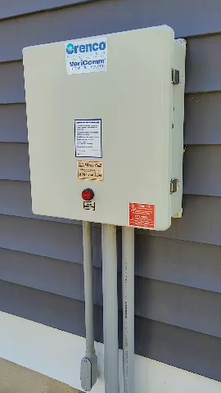
Alarm going off
Notes:
Problem – Alarm going off
Risk - Effluent may back up into home or surface in yard, poor treatment due to lack of air.
Causes -
Pump failed or undersized
Fuse breaker tripped
Pump plugged
Controls malfunctioning
Water infiltration
Excessive water use
Frozen or blocked pipe
Solutions
Control water use
Check breaker & plugs
Check controls & pump
Make sure a professional replaces pump with proper size unit
Fix leaks in plumbing, tank, or piping
Hire a professional to thaw the system

Slide 9
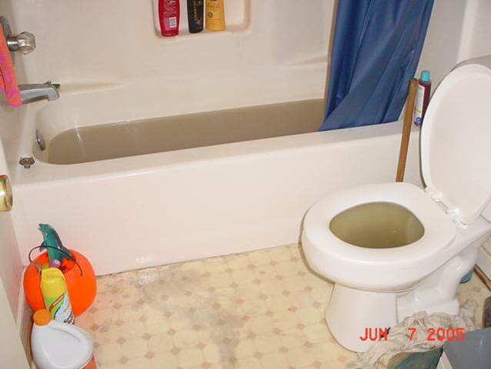
Wastewater backing up in the home
Notes:
Problem – Sewage backing up in home or on the surface
People experiencing onsite system malfunctions automatically curtail their water use. What does that mean for families, for their quality of life and personal sanitation? If people experience backups like this when it rains, how does that change their water use?
Risk - Human contact with sewage is a serious public health risk. Many waterborne diseases exist in household sewage
Causes –
Excess water entering system
Improper plumbing
Blockage in plumbing
Improper operation
Pump/control panel failure
Improper system design
Roots clogging pipes
Improper venting
The system is frozen or flooded
Solutions
Fence off area or operate as a holding tank until fixed
Fix leaks/vents
Install water-saving fixtures
Stop using garbage disposal
Pump septic tank and check pump(s)
Replace broken or cracked pipes and remove roots
Avoid planting water loving trees
Seal pipe connections
Hire a professional to thaw the system

Slide 10
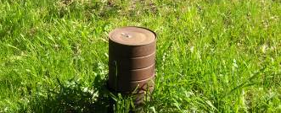
Sewage odors in the yard
Notes:
Problem - Sewage odors inside or outside the house, coffee can used instead of a tight fitting cap
Risk - Toxic gases can cause discomfort or illness.
Causes –
Improper plumbing
Sewage surfacing in yard
Sewage backup in house
Unsealed basement/crawl space sewage pump
Roof vent pipe frozen shut or blocked
Solutions
Repair plumbing
Pump septic tank and check pump(s)
Add water to drain traps in the house
Tighten seals on pump(s) and cleanout(s) thaw or clear roof vent

Slide 11
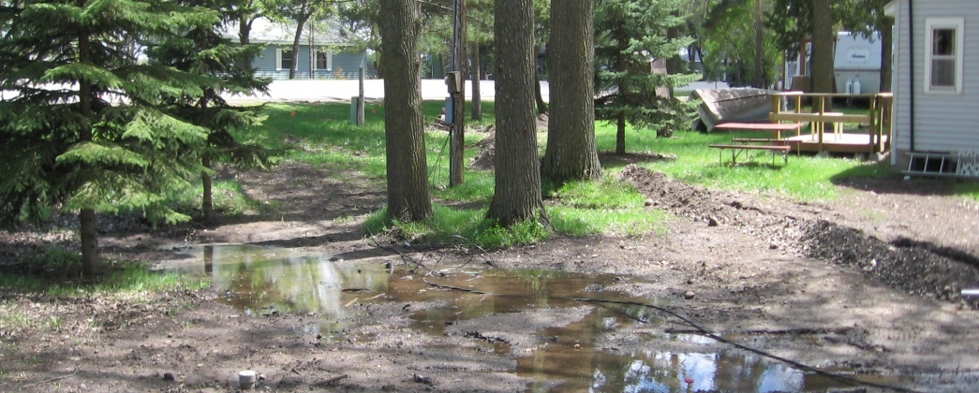
Electrical cord running through surface water to pump and poor surface drainage
Notes:
Problem – Power failure, electrocution and poor surface drainage
Risk - Effluent may back up into home or surface in yard, infiltration of surface water
Causes –
Fuse breaker tripped
Lack of power supply
Electrical line cut to system components
Improper grading and lack of vegetation
Solutions
Control water use
Check fuse box and see if tripped, if tripped evaluate why
Have a professional evaluate where the power failure is if the system is the only impacted feature.
Provide proper drainage and good surface cover such as grass.

Slide 12
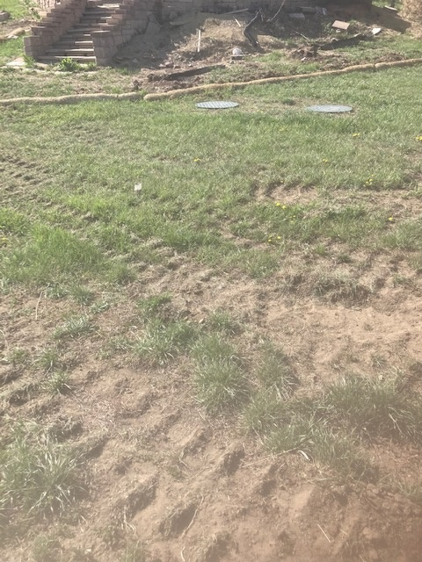
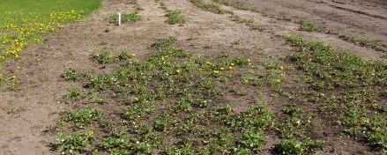
Lack of vegetation and compaction
Soil treatment areas
Notes:
Problem – Lack of vegetation and compaction
Risk - Effluent may back up into home or surface in yard or system may malfunction prematurely due to lack of oxygen.
Causes –
Traffic over the system during or after installation
Lack of vegetation establishment – improper topsoil, seeding and/or watering
Solutions -
Consult with septic professional
Shallow aeration (core or spike aerator)
Replant area

Slide 13
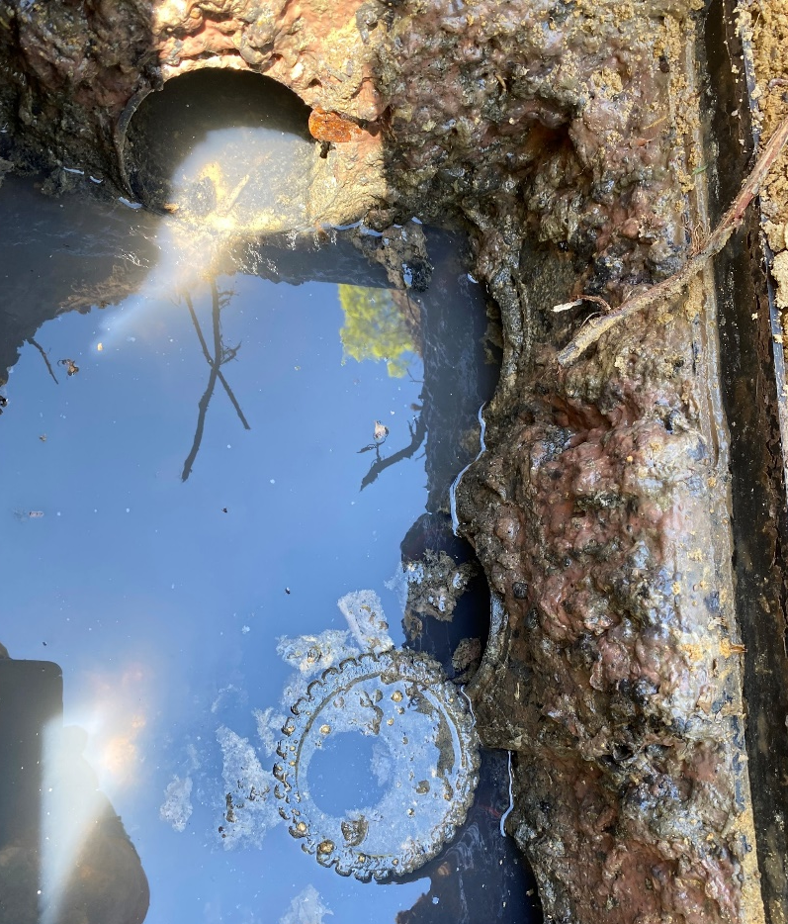
Crushed and overloaded distribution box
Notes:
Problem – Crushed and swamped distribution box - The inlet is at top of frame and there are three inlets to the right. The speed levelers popped out and you can see that the water level is above the invert in all the outlets. The field may be taking some water very slowly but is hydraulically overloaded.
Risk - Effluent may back up into home or surface in yard, premature replacement.
Causes –
Over use of water
Overloading of soil – use, lack of maintenance
Unlevel distribution
Solutions -
Consult with septic professional
Clean tanks and lines
Confirm equal distribution
Possible repair or replacement

Slide 14
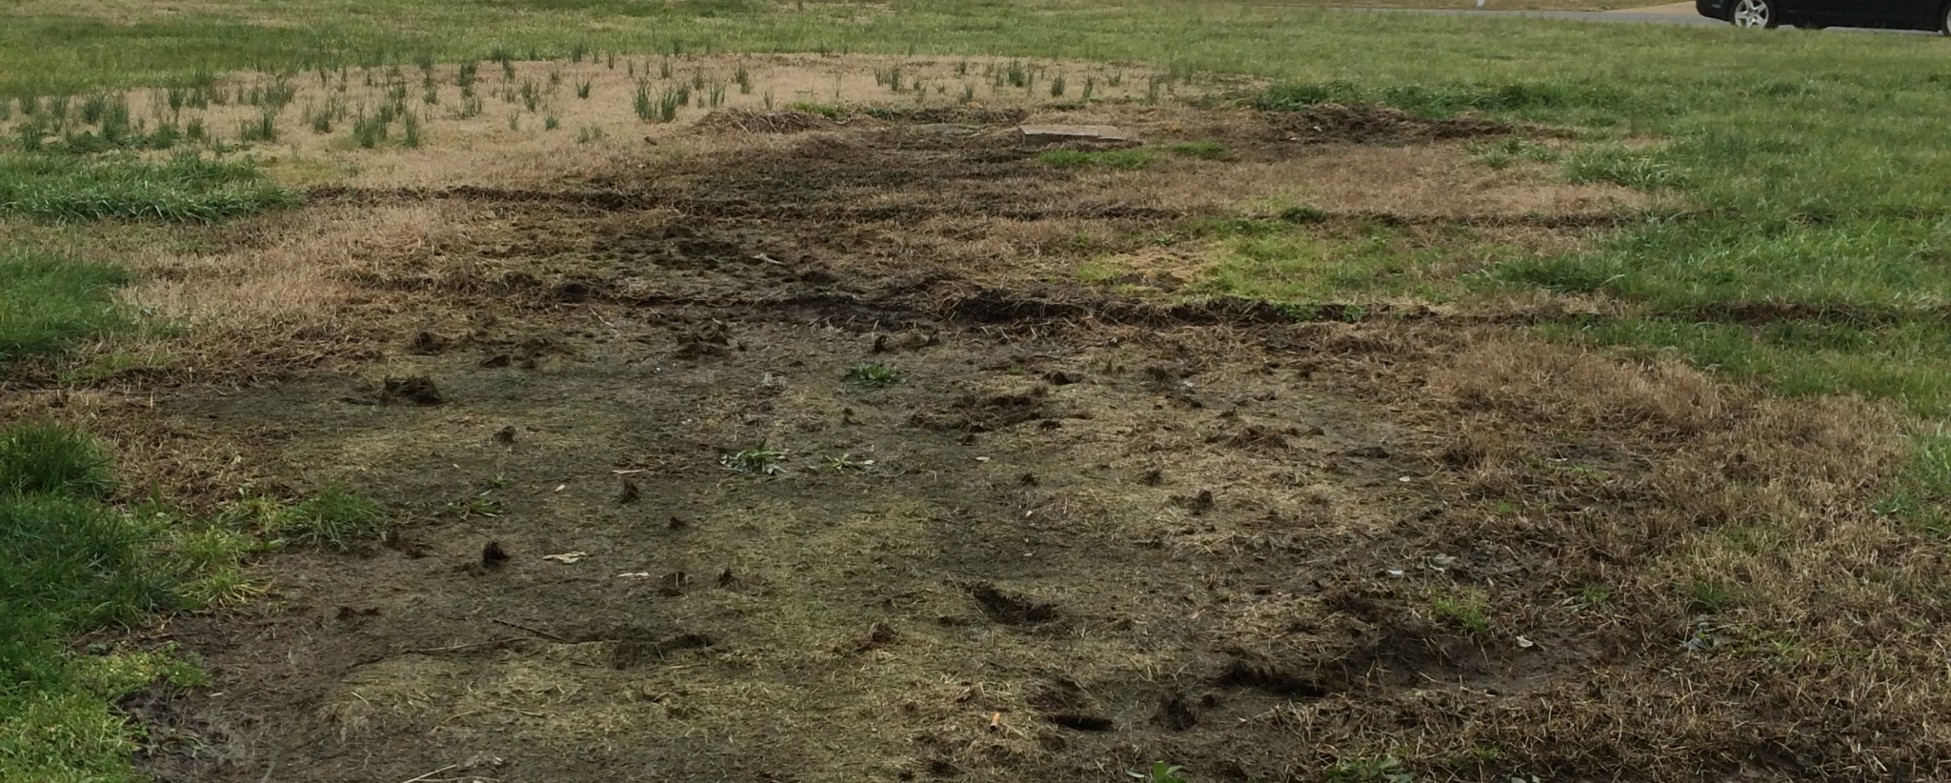
Surfacing of effluent and traffic over the system
Soil treatment area
Notes:
Problem – effluent on the surface due to pump failure and traffic over the system
Risk – Contact with sewage, public health issue, may also runoff to surface water, compaction over the system.
Causes
Controls malfunctioning
Fuse breaker tripped
Lack of power supply
Electrical line cut to system components
Heavy traffic
Solutions
Control water use
Check breaker & plugs
Check controls & pump
Make sure a professional replaces pump with proper size unit
Do not drive over septic system

Slide 15
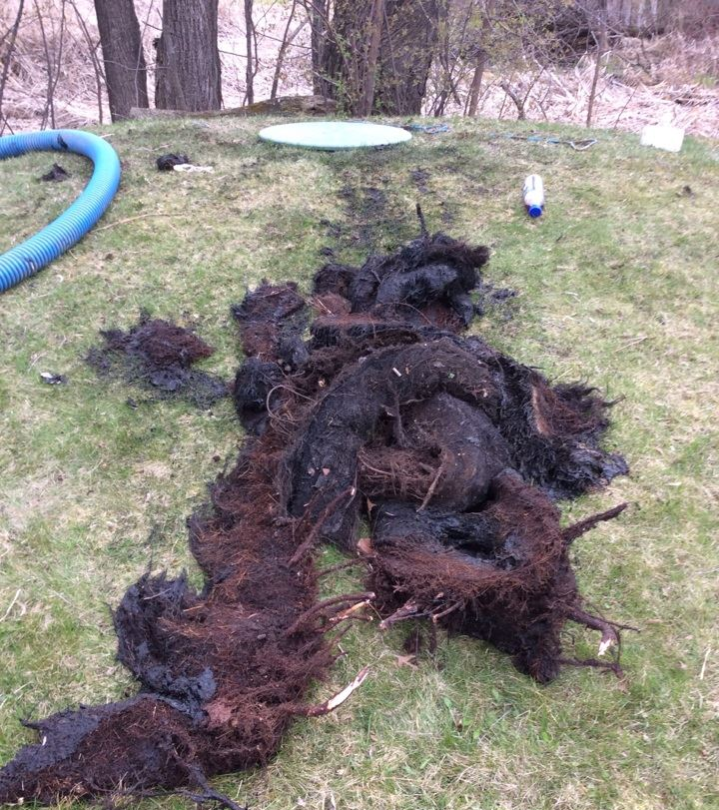
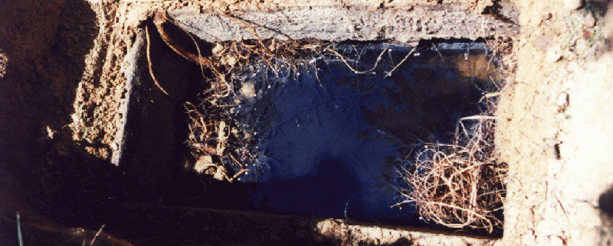
Roots in a distribution box and out of a septic tank
Notes:
Problem – Photo 1 roots in a distribution box, Photo 2 – roots that were removed from a septic tank.
Risk - Effluent may back up into home or surface in yard, premature replacement.
Causes –
Over use of water
Overloading of soil – use, lack of maintenance
Unlevel distribution
Solutions -
Consult with septic professional
Clean tanks and lines
Confirm equal distribution
Possible repair or replacement

Slide 16
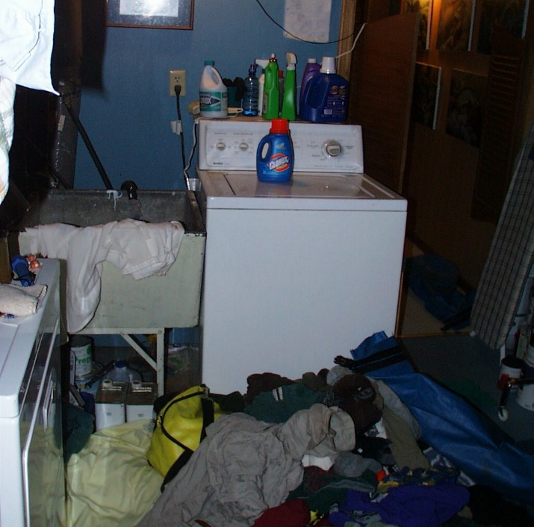
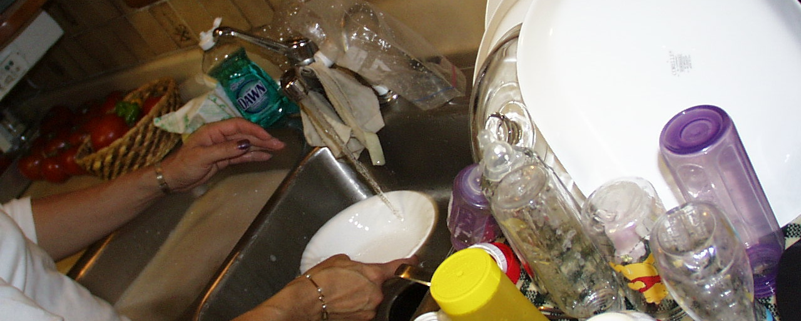
Using more water than need or not spacing out usage
Notes:
Problem: Excessive water use can cause hydraulic overload - photo 1 running water to wash dishes, photo 2 too much laundry on one day
Risk - Effluent may back up into home or surface in yard, premature replacement.
Causes –
Homeowner usage
Solutions -
Fill up the sink with water versus leaving it running
Space out usage

Slide 17
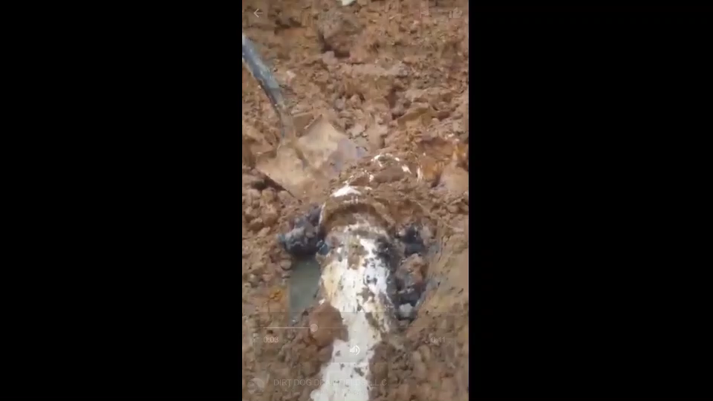
Broken pipe full of fat, oil and grease
Notes:
Add speaker notes

Slide 18
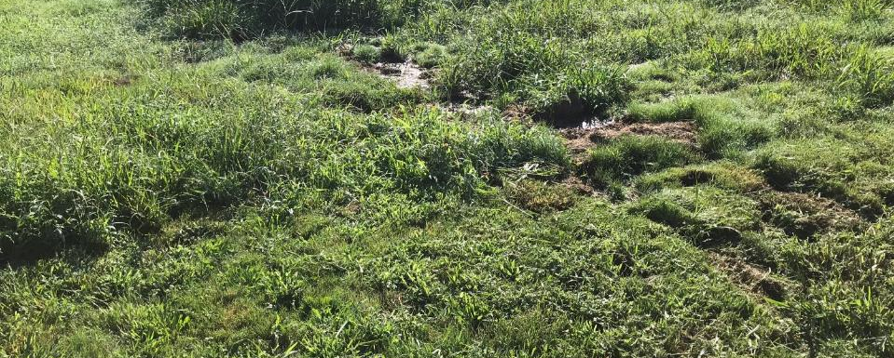
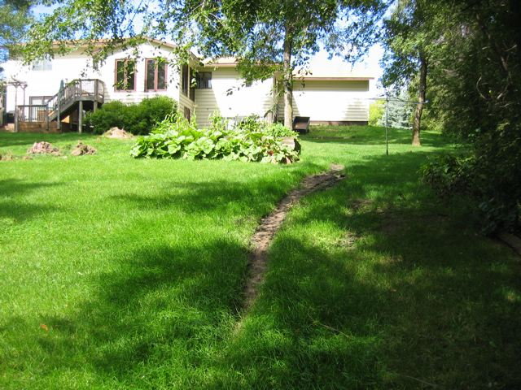
Surfacing of sewage in the yard = health threat
Notes:
Problem – effluent on the surface - trail down the hill is the path of sewage
Risk – People, pets, insects and vermin may come in contact and carrying sewage with disease causing organisms.
Causes -
Improper installation
Old outdated system
Soil treatment area malfunction
Overuse and lack of maintenance
Solutions
Control water use
Determine cause of surfacing
Leaky toilets
Repair or replacement

Slide 19
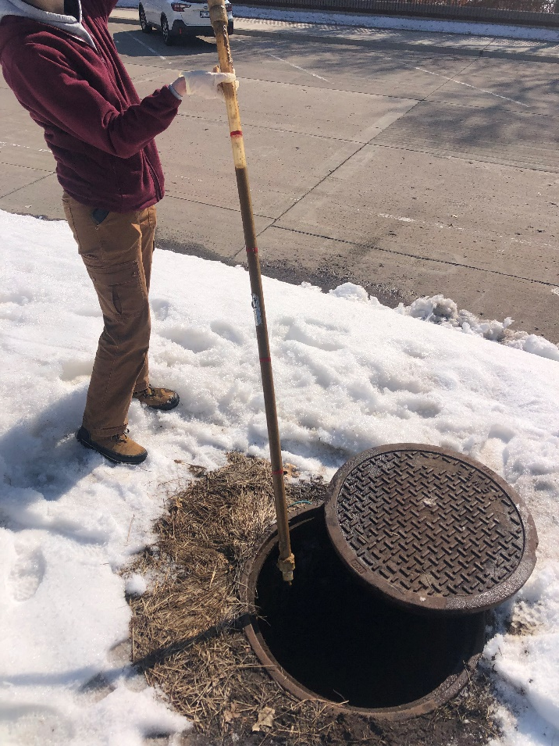
Lack of septic tank maintenance
Notes:
Problem – sludge judge with no clear zone.
Risk - Effluent may back up into home or surface in yard, premature replacement.
Causes –
Over use of water
Overloading of soil – use, lack of maintenance
Unlevel distribution
Solutions -
Consult with septic professional
Clean tanks and lines
Confirm equal distribution
Possible repair or replacement

Slide 20
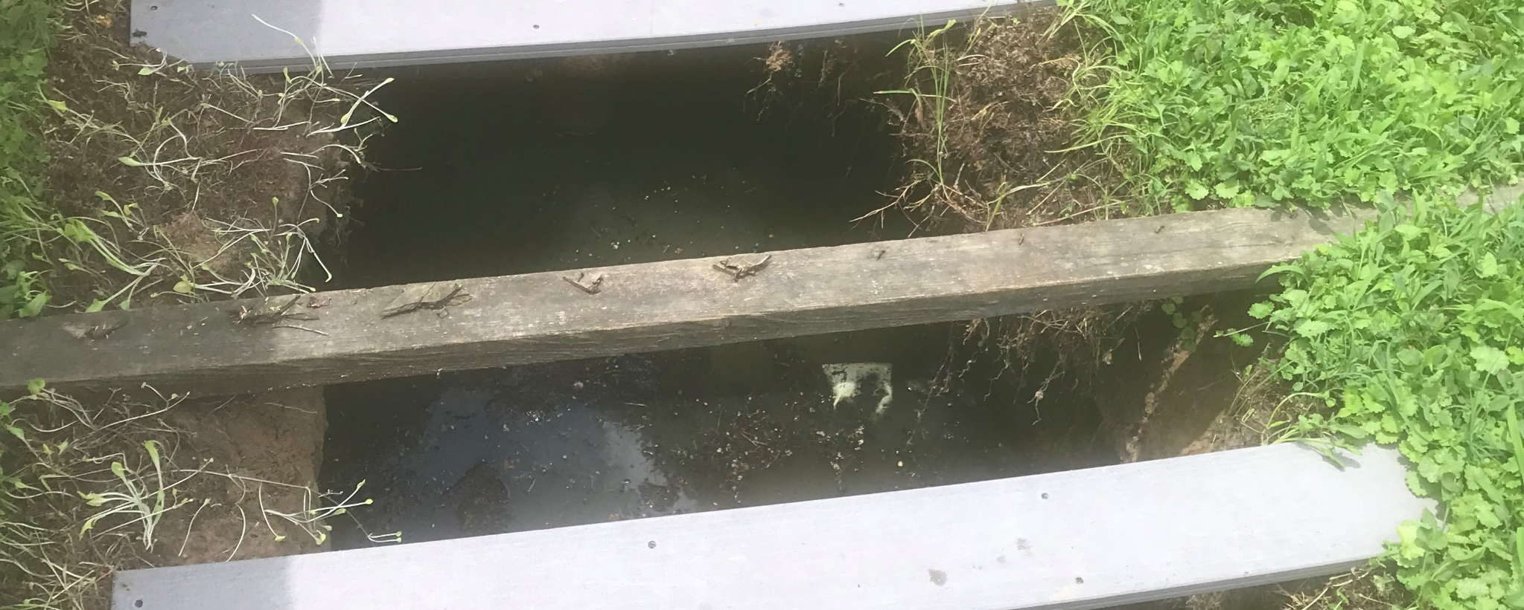
Tank lid collapse – safety issue
Notes:
Problem – no tank lid – lids can either be missing or become damaged
Risk – Safety issue due to drowning and public health issue due to people, pets, insects and vermin potential contact and carrying sewage with disease causing organisms.
Causes -
Improper installation
Damage or broken tank components
Heavy traffic over a system
Solutions
Prevent access
Repair or replacement

Slide 21
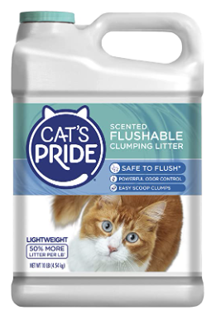

Flushing of inappropriate materials
Notes:
Problem – flushing of improper materials - Toilet should not be used as a garbage can
No such thing as “Septic Safe” This is a “clay based litter” which is not appropriate for a septic system. These products can cause plugging of pipes, accumulate in tanks and negatively impact downstream components.
Risk – sewage on backing up or surfacing in the yard, costly maintenance visits such as pump replacement.
Causes – improper use and disposal of inappropriate solid waste into septic system
Solutions
Stop use of such items
Clean out tanks and other components impacted by the material
Repair or replacement

Slide 22
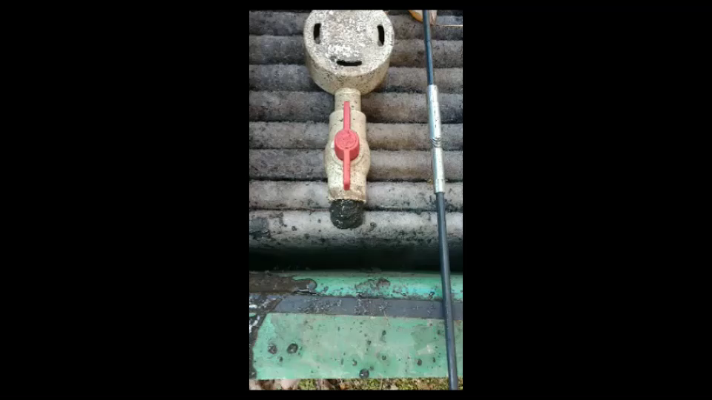
Sludge coming out of a pipe in a media filter
Notes:
Problem – sludge in downstream components – think sludge being flushed from in the lines of media filter.
Risk – Surfacing or backing up of components, premature malfunctions.
Causes -
Hydraulic or organic overload
Lack of maintenance
Solutions -
Clean out all components
Repair or replacement

Slide 23
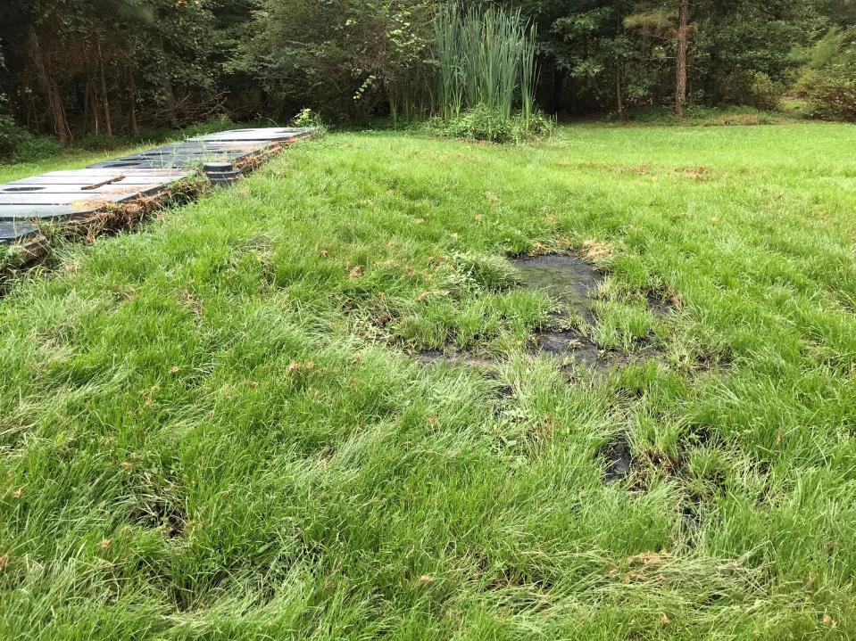
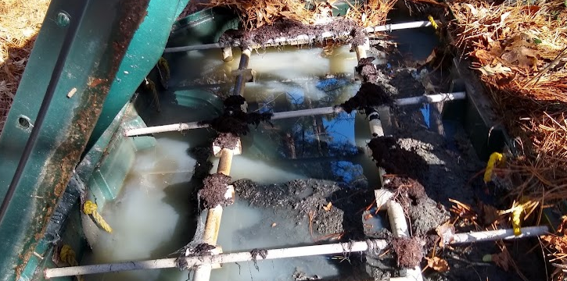
System that had not had routine maintenance for 10 years
Notes:
Problem – ponding and surfacing of effluent – A peat filter pad system that had had no maintenance in the decade since it had been installed. You can see in the middle of the top of the photo that cattails had taken root in the wet area.
Risk – Sewage at surfacing allowing people, pets, insects and vermin may contact and carry sewage with disease causing organisms.
Causes -
Lack of maintenance (cause for this one)
Improper design/installation
Hydraulic or organic overload
Solutions
Clean out all components
Repair or replacement of peat or entire system

Slide 24
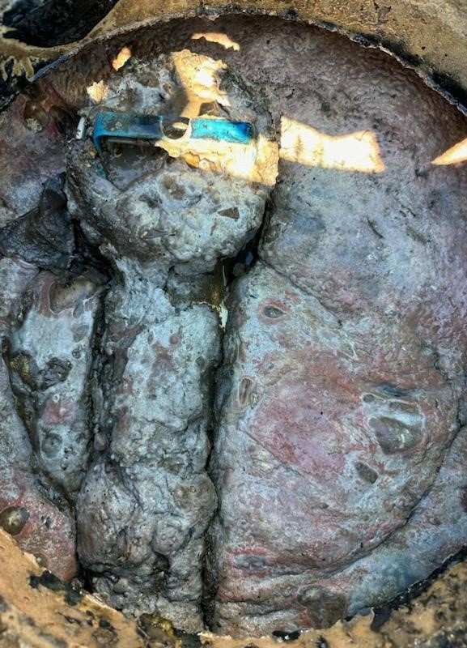
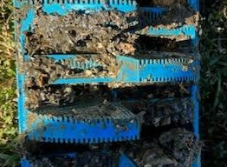
Plugged up effluent screen
Notes:
Caption – lack of maintenance and disposal of fats, oils and grease into system.
Problem – no tank lid – lids can either be missing or become damaged
Risk – Safety issue due to drowning and public health risk due to intreated sewage at the surface
Causes -
Improper installation
Damage or broken tank components
Heavy traffic over a system
Solutions
Prevent access
Repair or replacement

Slide 25
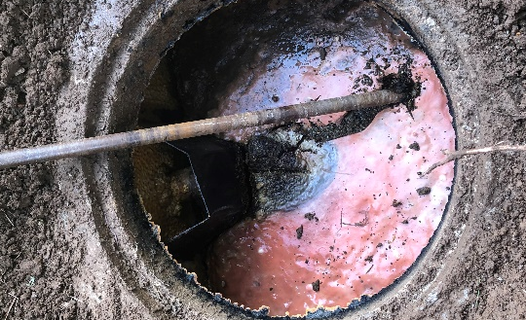
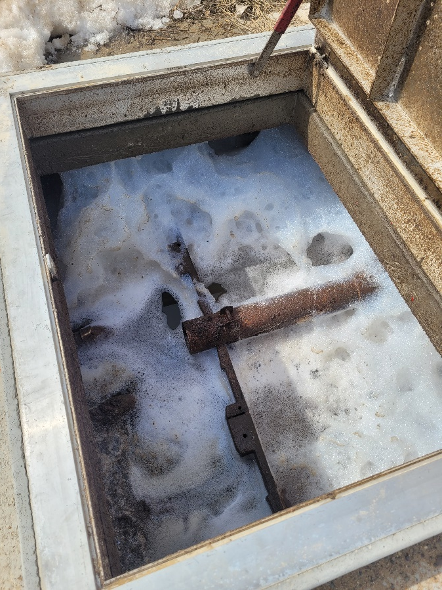
Chemical/soap upset of the OWTS
Notes:
Caption – Photo 1 - system with paint washed down the drain, Photo 2 – excessive use of soap in an aerobic treatment unit.
Problem – Improper disposal and excessive use of cleaners and soaps upset system
Risk – OWTS can not handle hazardous waste such as paint and excessive cleaner usage can harm microbes in the system.
Solution – take hazardous waste to proper disposal sites and limit cleaners to the minimal needed while choosing biodegradable options.

Slide 26
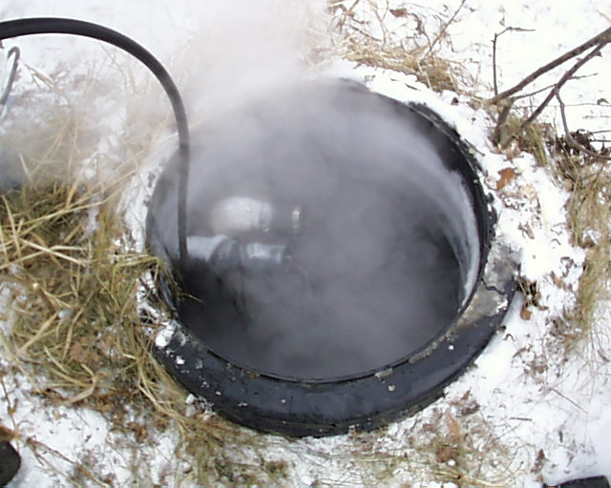
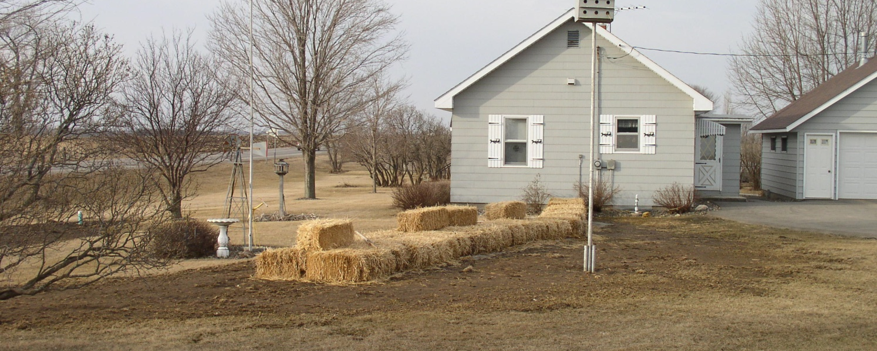
Frozen system and straw bales for insulation not removed
Notes:
Captions 1 – phone 1 thawing of a frozen systems, photo 2 straw balls used to insulate not removed in the spring which will cause a lack of vegetation
Problem – Freezing, then lack of vegetation
Risk - Effluent may back up into home or surface in yard
Causes – X
Remedies – X
Use an insulting blanket

Slide 27
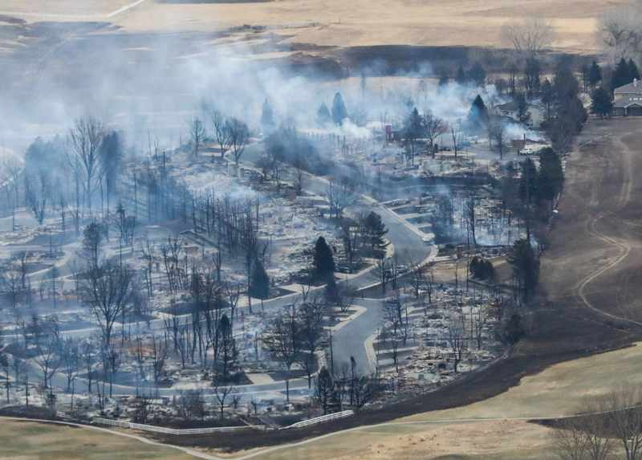
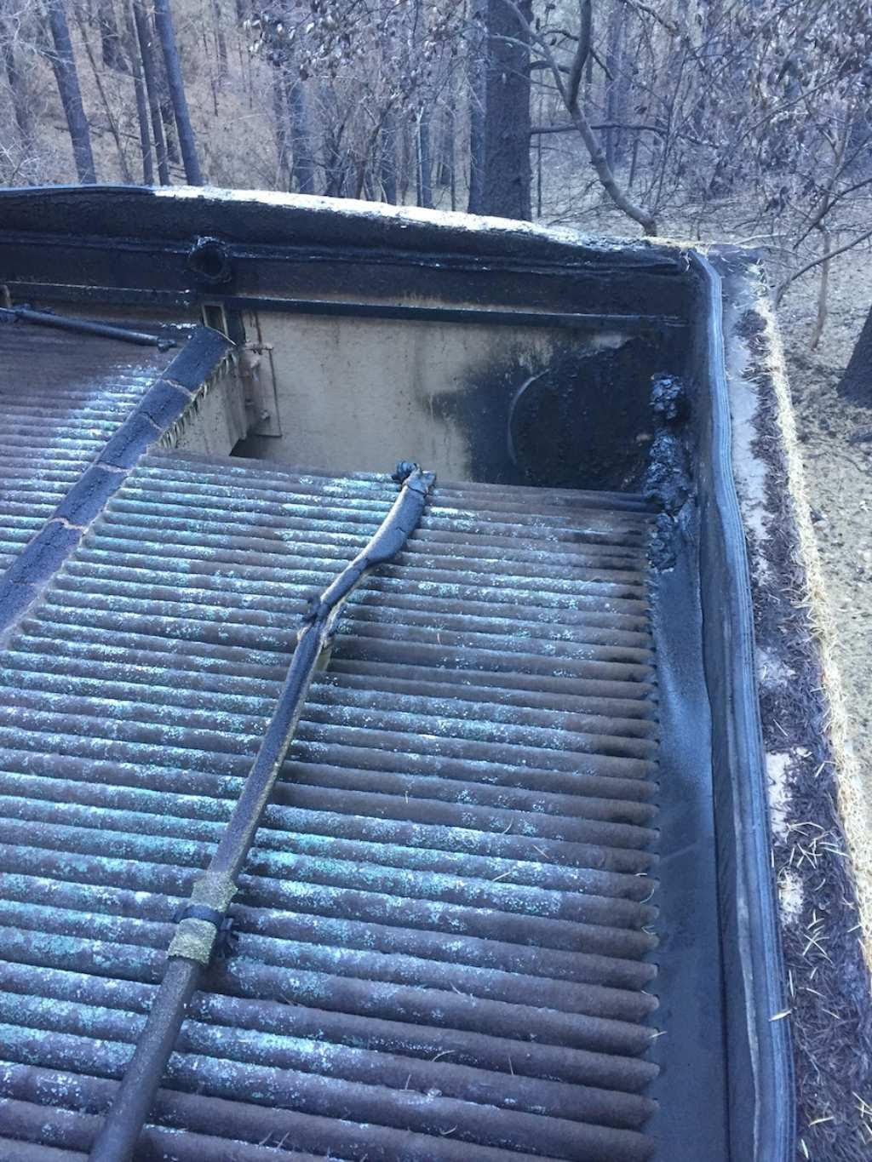
Fire over the OWTS media filter
Notes:
Photo 1 – South Vale Subdivision after a forest fire, Photo 2 – Media filter burned/melted by a forest fire.
Problem – Fire over the System
Risk - System components above the ground and shallowly buried may have been damaged
Solutions
Evaluate safety concerns due to exposed/damaged components
Hire a professional to evaluate the system
Repair damaged components prior to use

Slide 28
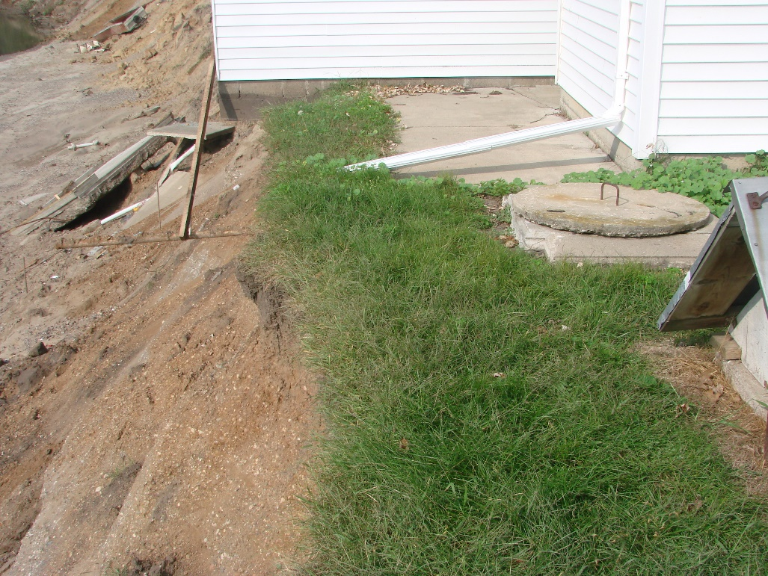
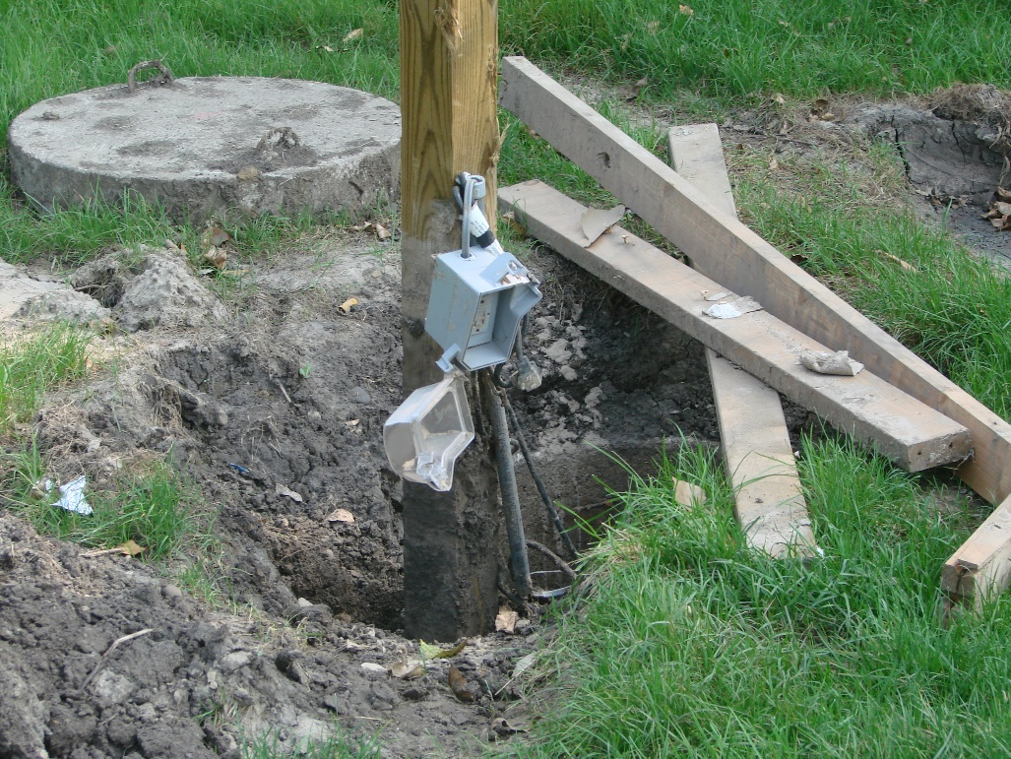
Flooding over the OWTS
Notes:
Left – Washed away OWTF in eroded stream bank. Right – Flood damaged electrical box
Problem – Flooded System
Risk - System components above the ground and shallowly buried may have been damaged
Solutions
Evaluate safety concerns due to exposed/damaged components
Hire a professional to evaluate the system
Repair damaged components prior to use

Slide 29
Your Problems or Questions
Notes:
After pre-test or halfway through class collect note cards and start with answering submitted questions and then take others from the audience.

Slide 30
Resources
See back page of User Guide for:
  List of state regulatory contacts
  Product disposal and selection information
  National level resources from EPA, NOWRA and RCAP
Notes:
Note: add additional local resources.

Slide 31
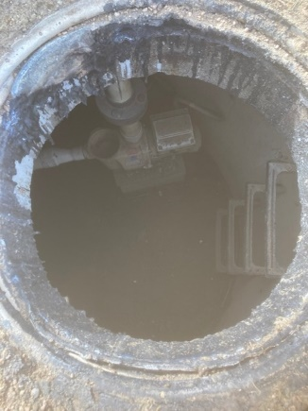
Conclusion of Module 4
Instructor name
Instructor contact information
Notes:
Picture on the left shows a melted riser

Slide 32
Post Test

Slide 33
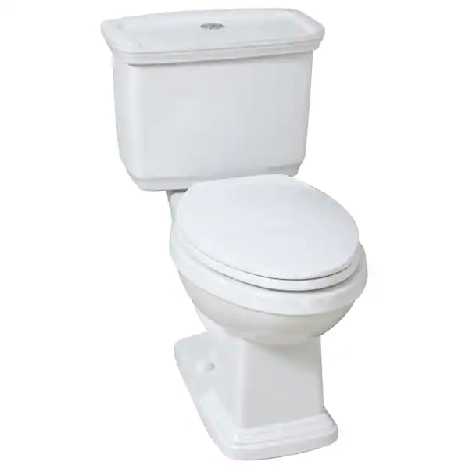
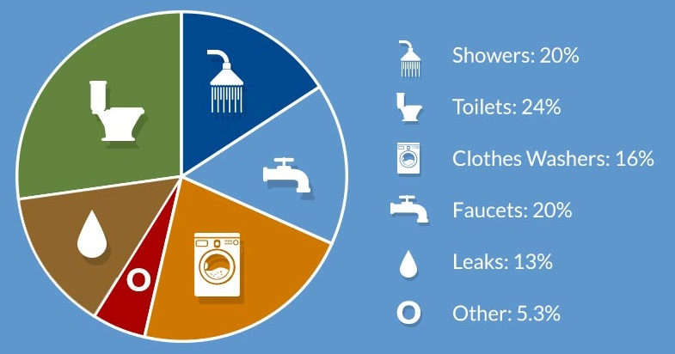
What device in the house uses the most water?
Clothes washer
Shower
Toilet
Faucets

Slide 34
At what percentage full of solids (sludge and scum) should a septic tank be pumped?
10%
25%
33%
50%
100%
25%

Slide 35
What is a problem with older toilets?
They use 5+ gallons per flush
Leaky gaskets
Notes:
Add short video on how to fix.

Slide 36
If you don’t know where your septic system components are located what can you do?
Contact your permitting authority for records
Reach out to the designer, installer, inspector, service provide who was involved with it was designed or hire one to locate it
Try to find it out your own

Slide 37
Course Evaluation
Instructor Name
Contact Information
Notes:
Thank attendees for coming to class and encourage them to share information with others.
Update the slide with your contact information.

